Slide 1
The Tang Hall Local History Group Presents
Heworth Business
Past & Present

Slide 2
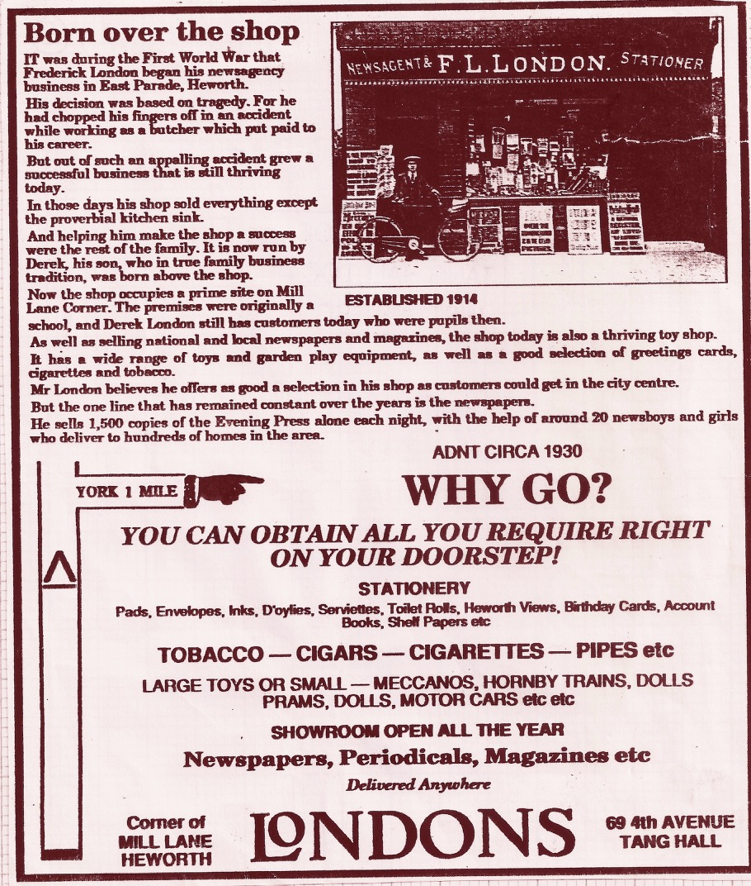
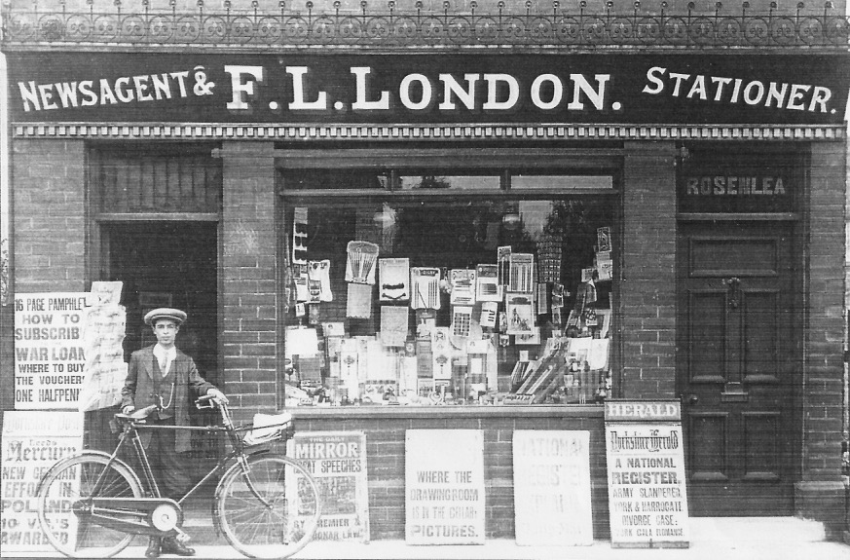
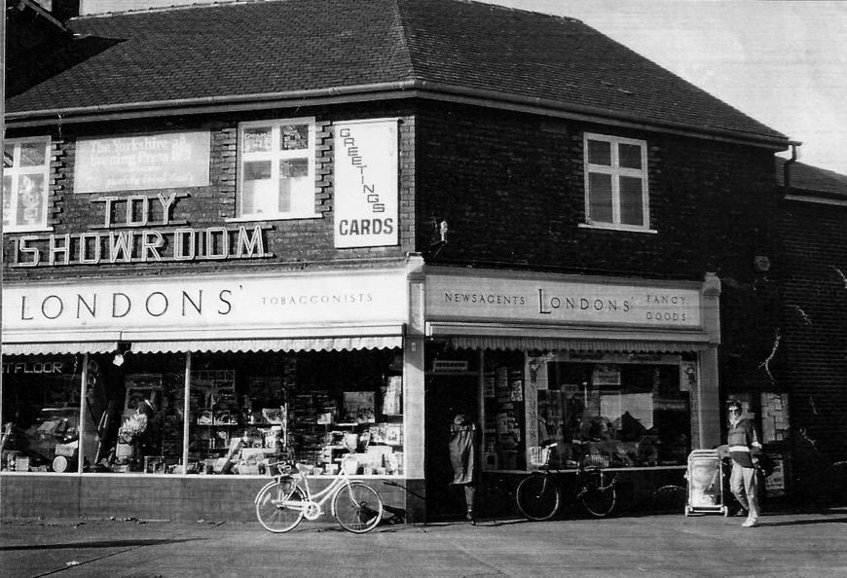
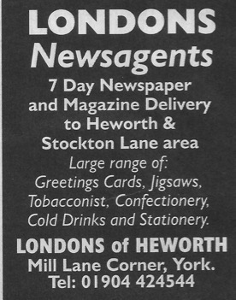
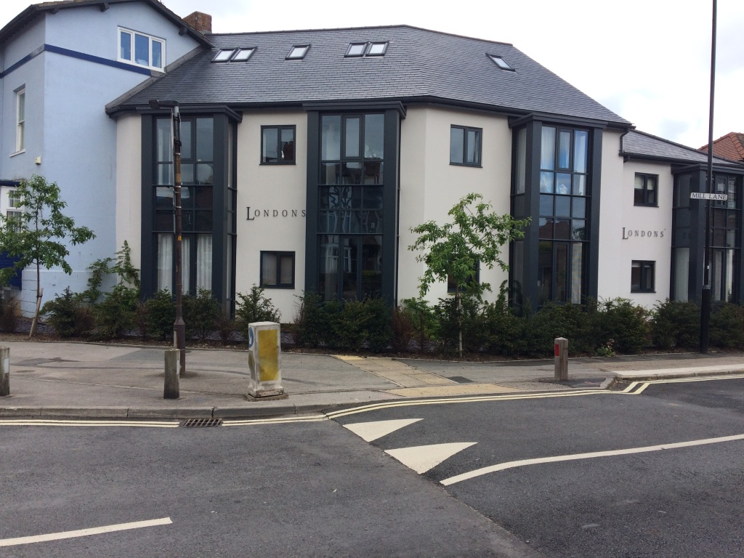
London’s
Perhaps the most well known of the Heworth
Shops, opened in 1914 by Frederick London and moved to the site on the corner of Mill Lane in the 1930’s

Slide 3
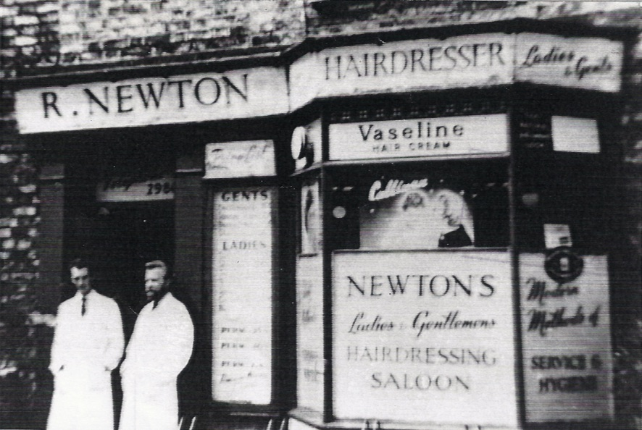
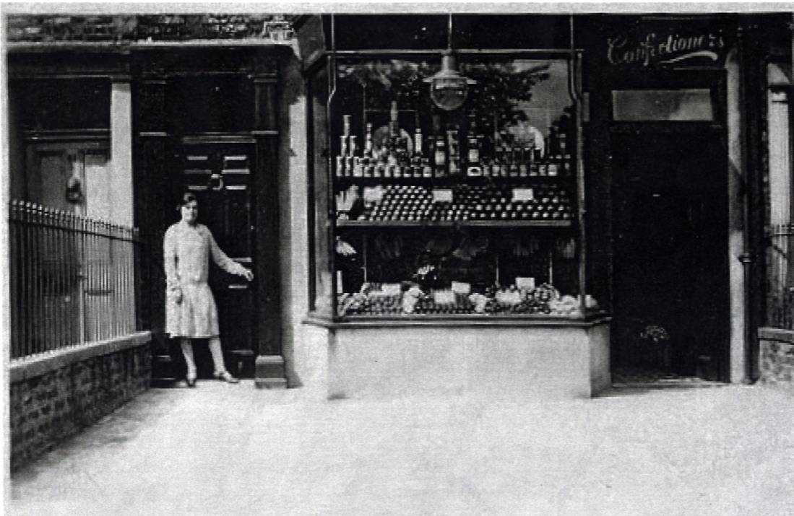
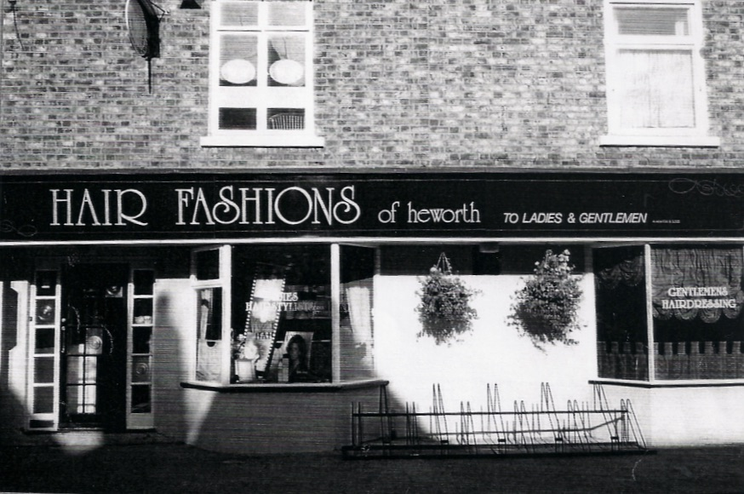
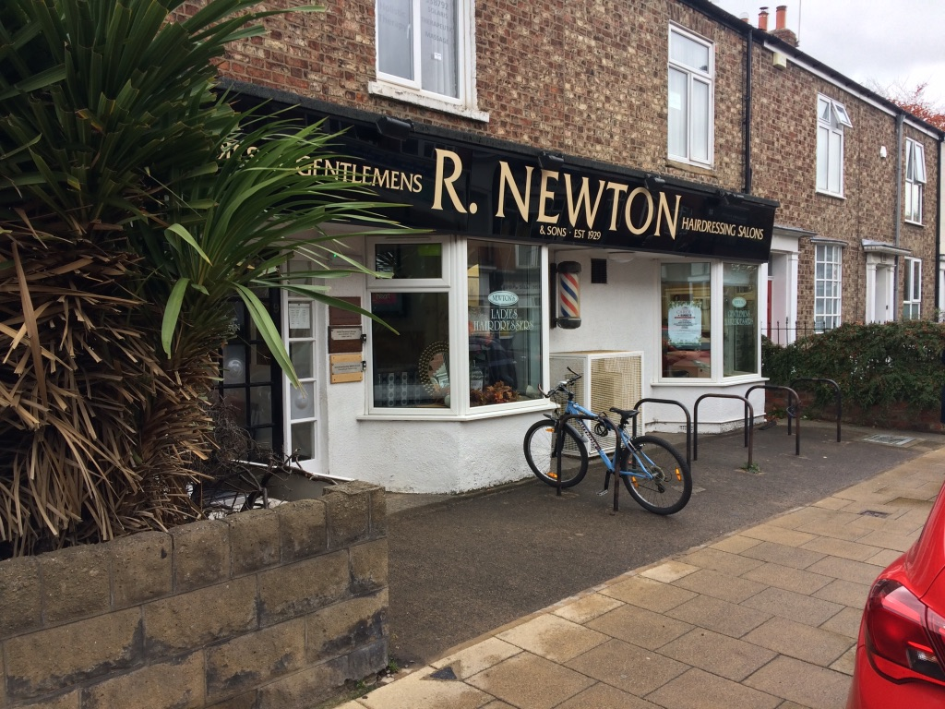
Newtons
Established around 1930 by Ron Newton, the business was taken over by son Peter who has now retired. The business is still in the family in 2020 and run by Peter’s children Paul and Dawn

Slide 4
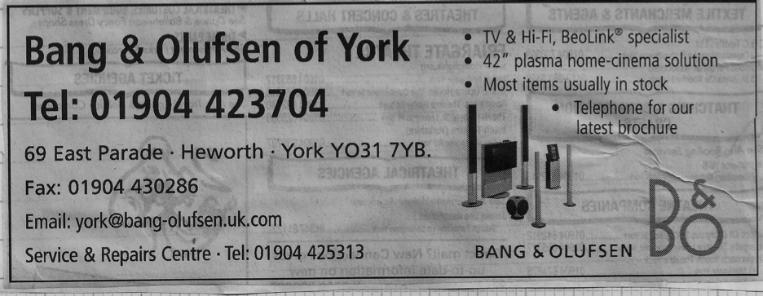
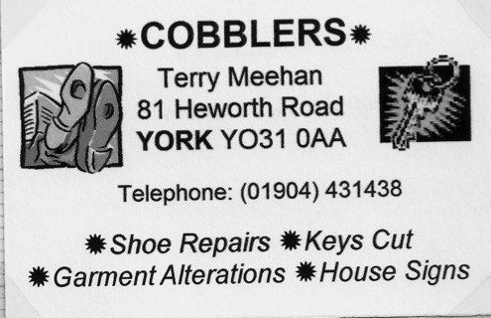
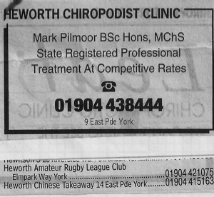
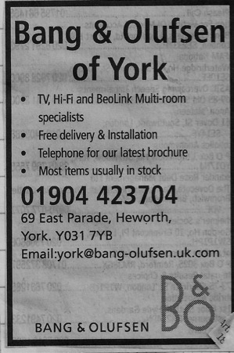
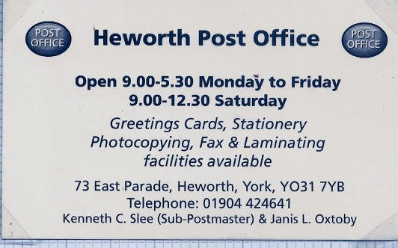
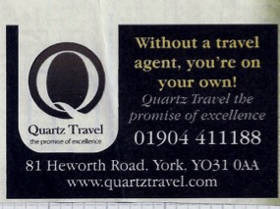
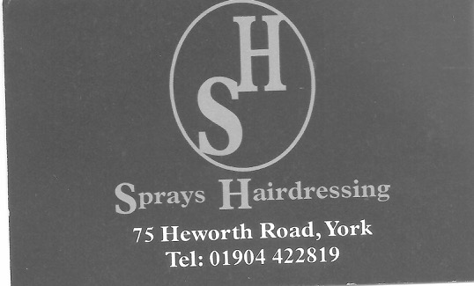
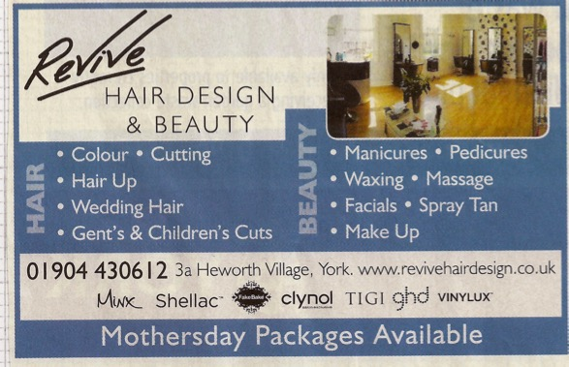
Business Cards and Adverts
The Bang & Olufsen shop is now occupied by Bean on the Green, Cobblers occupied the premises on Heworth Road now being used by Independent Living

Slide 5
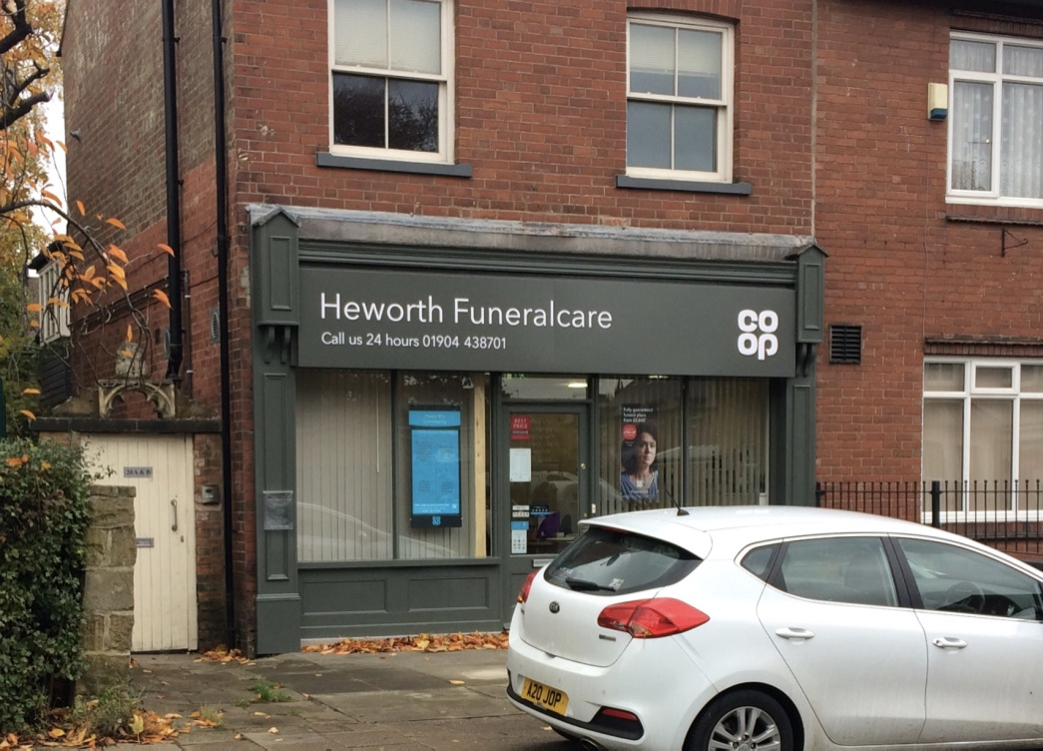
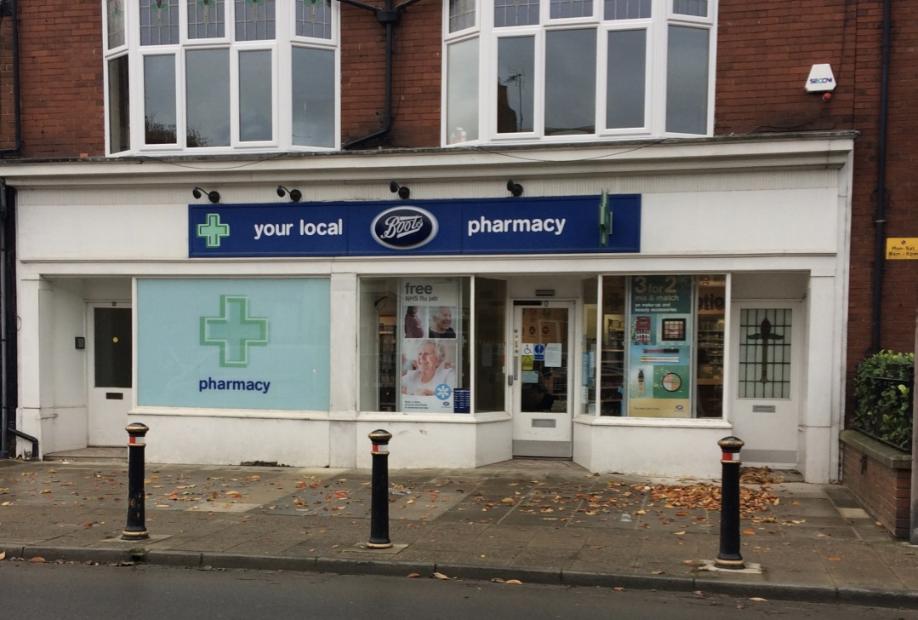
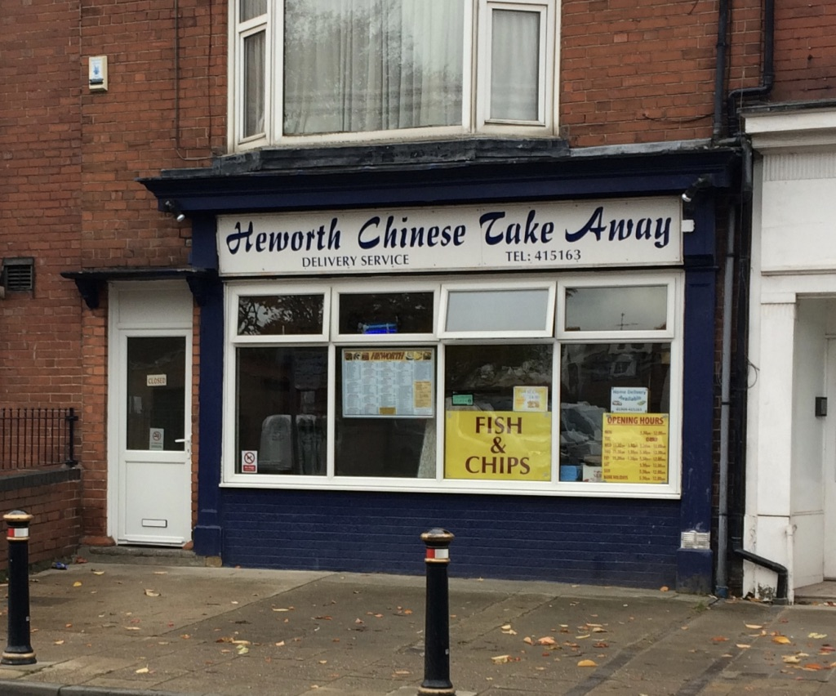
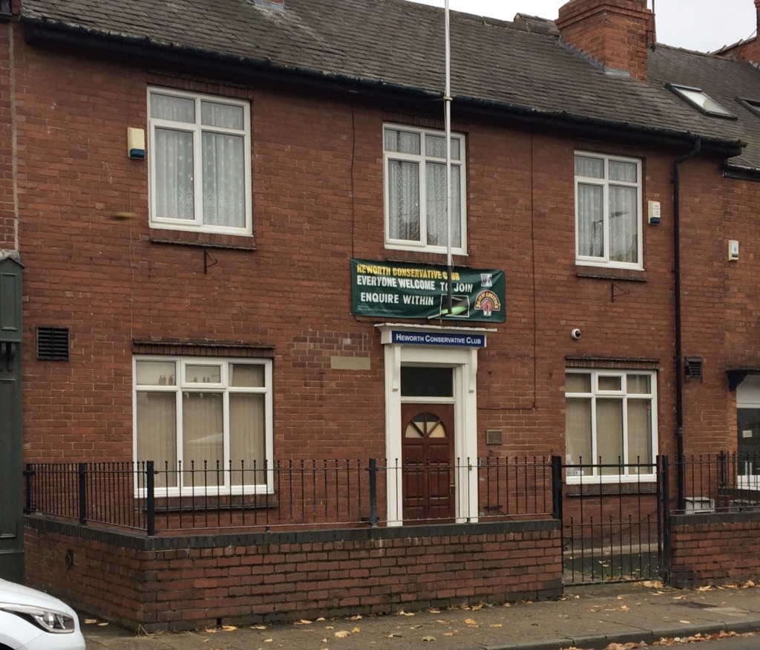
East Parade
Boots chemist took over the chemist shop from F W Wood, The Conservative Club has been on the site for over 50 years, it always had a reputation for having an excellent snooker team
The Chinese takeaway was originally Glen Fisheries, despite its title the Chinese still serves traditional Fish & Chips
The Coop Funeral care unit was originally Glen Stores and later became Threshers Wine Shop

Slide 6
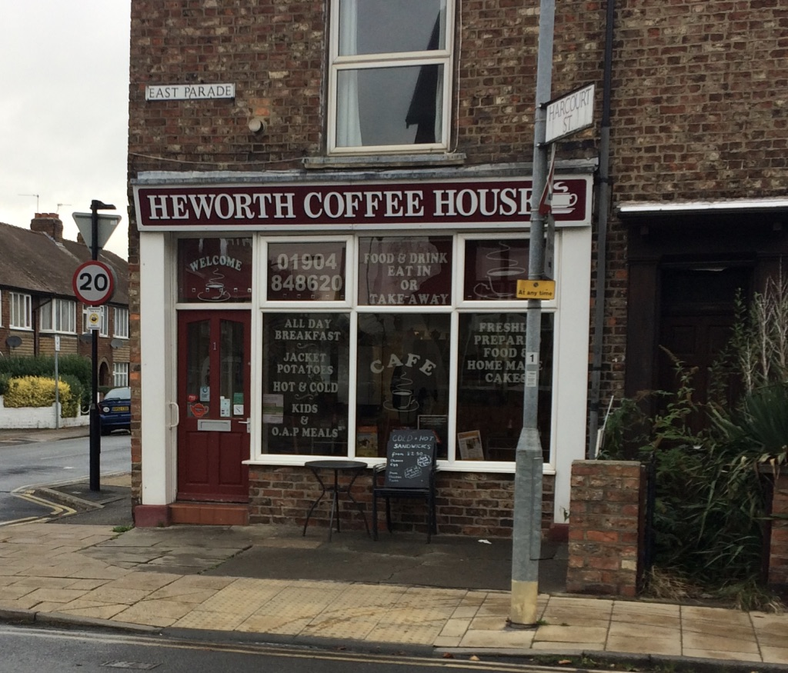
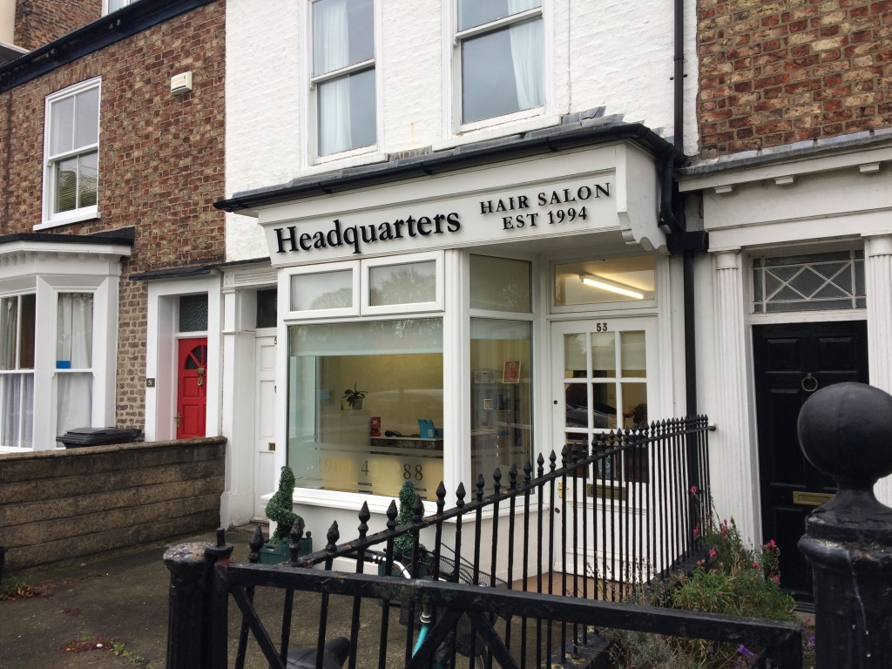
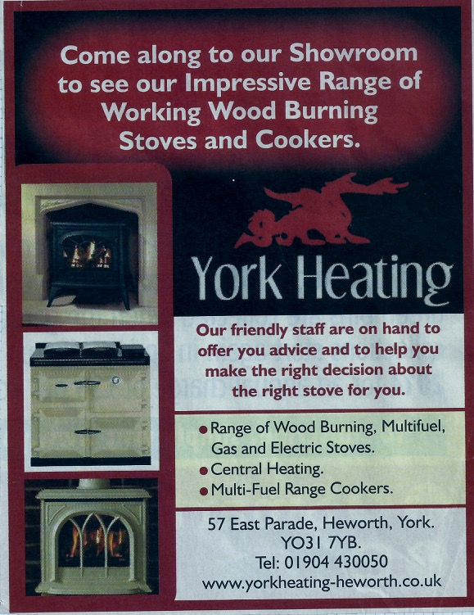
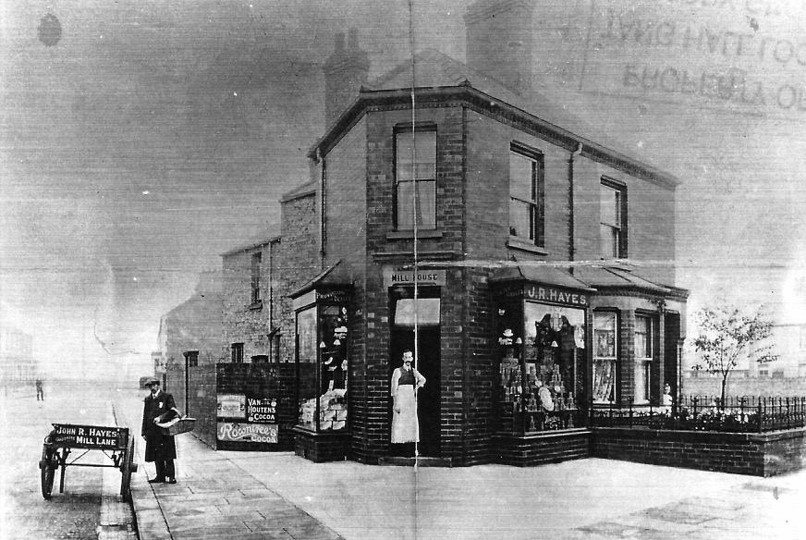
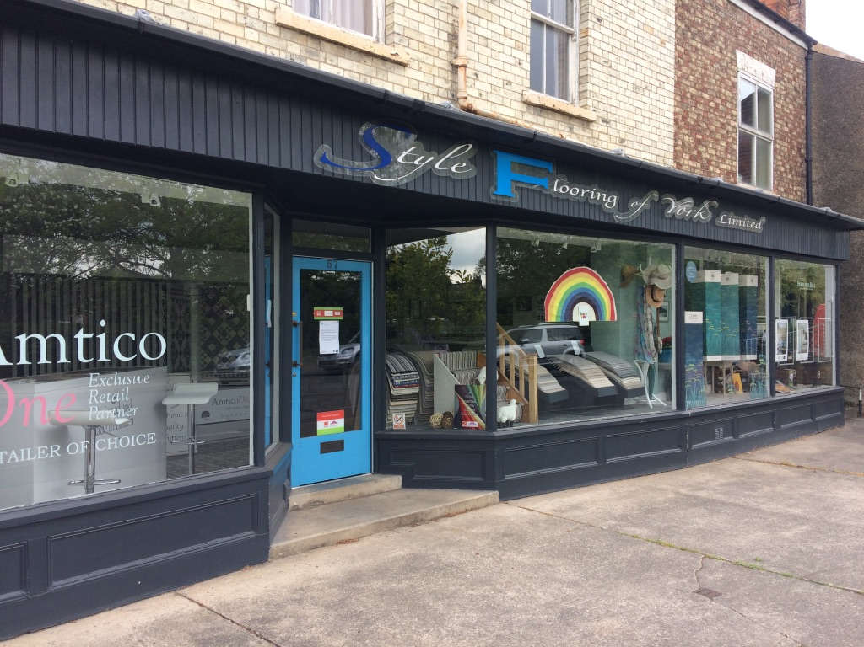
East Parade
The Heworth Coffee house was originally Cochranes Grocers shop and later became Bolan Dale Financial Advisors
Headquarters was originally Oliver’s Fruit and Veg shop and when it changed use became Part Two hair salon
Style flooring was originally Bacons painting & decorating business, it later became York Heating supplies

Slide 7
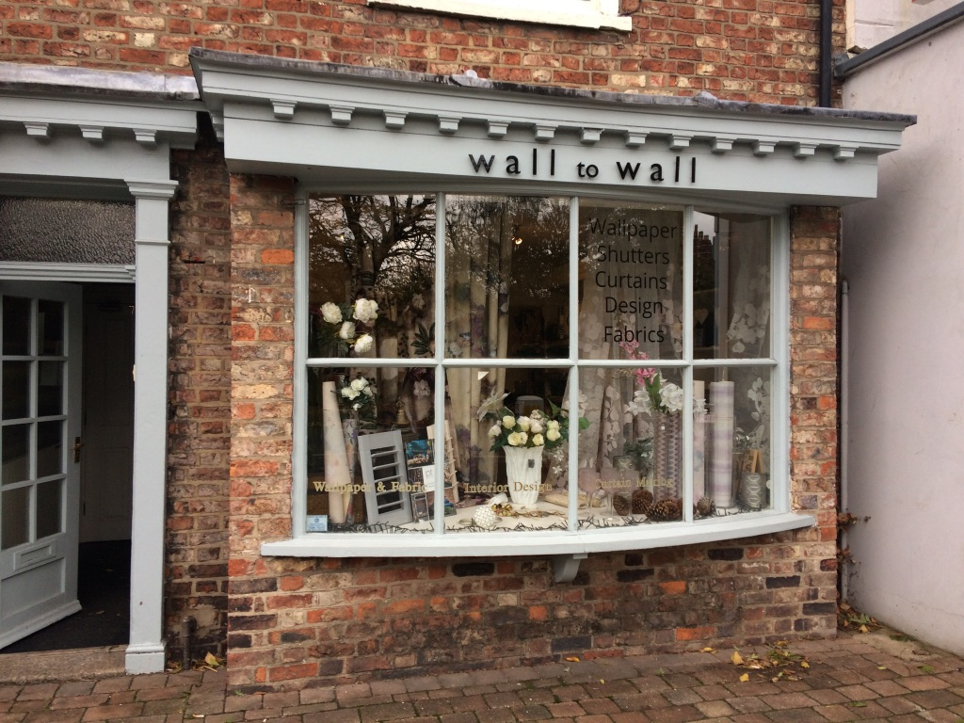
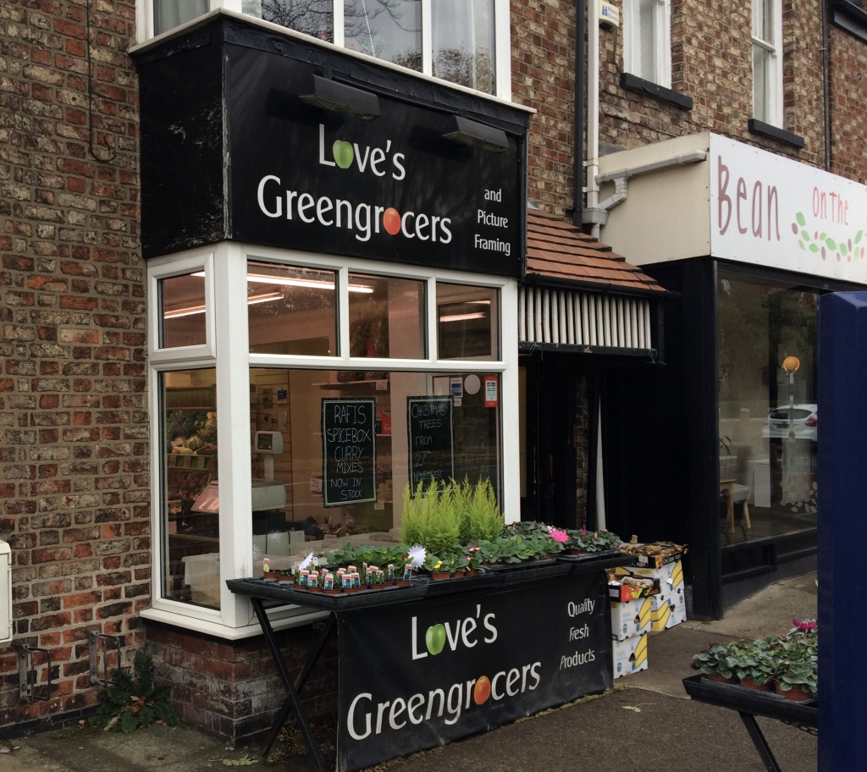
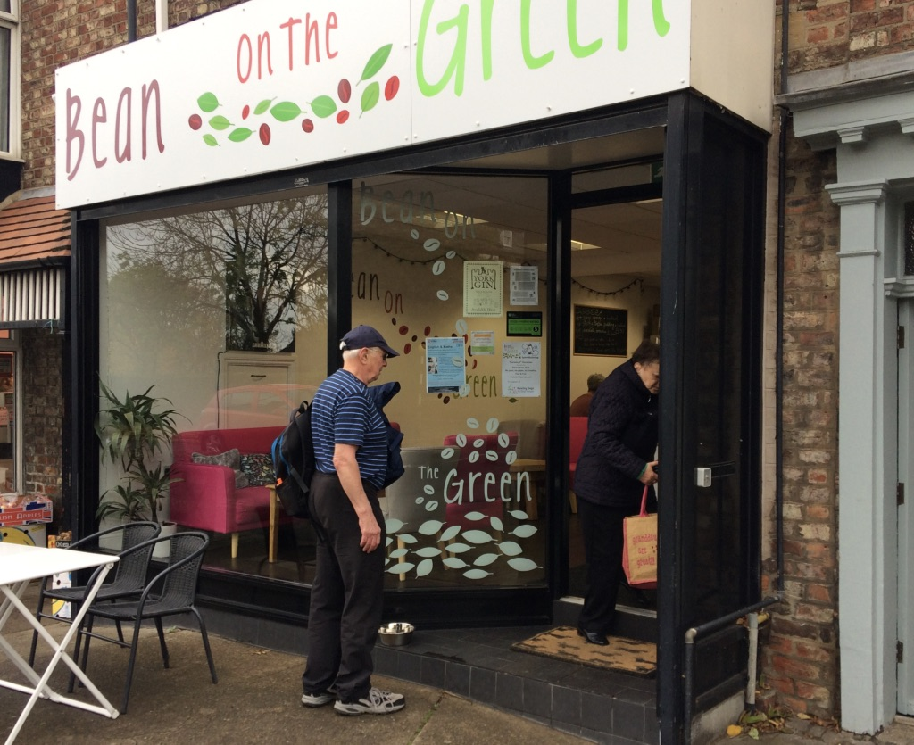
East Parade
Wall to Wall was originally Deighton’s Boot Shop, it later became Ambers Interiors
Love’s Greengrocers was formerly The Glen knitting wool shop
The Bean on the Green was originally Allan’s Chemists shop, it later became a Hi Fi outlet for Bang & Olufsen and the Beehive beauty salon
The Bean on the Green opened in 2017 and now houses a small display of the Tang Hall Local History Group

Slide 8
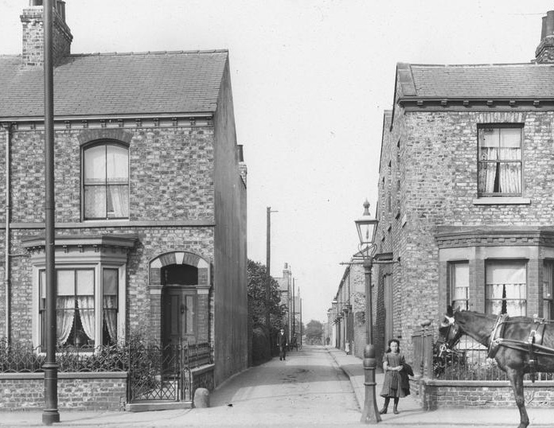
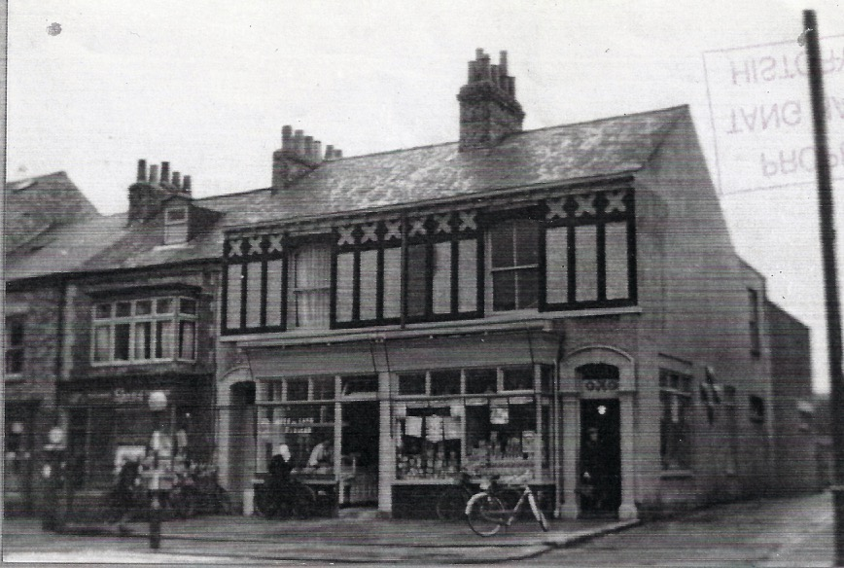
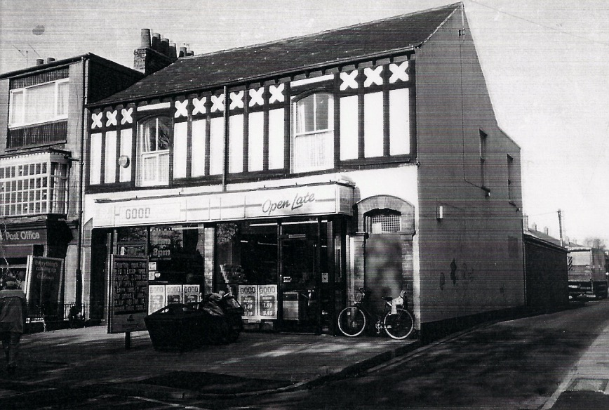
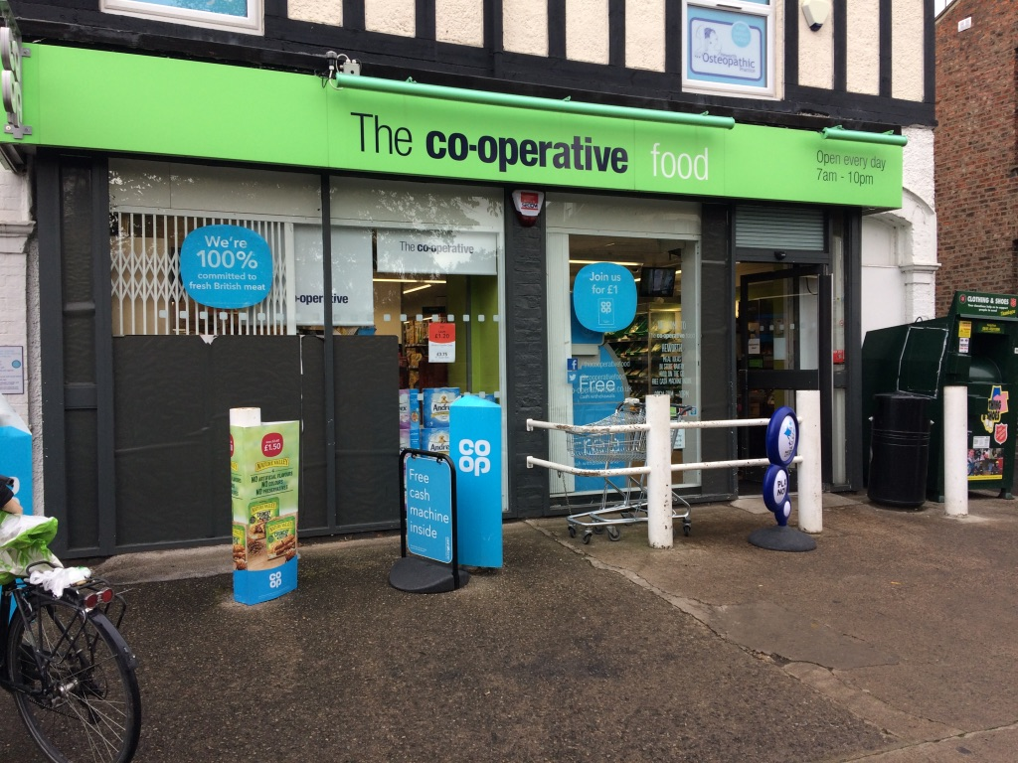
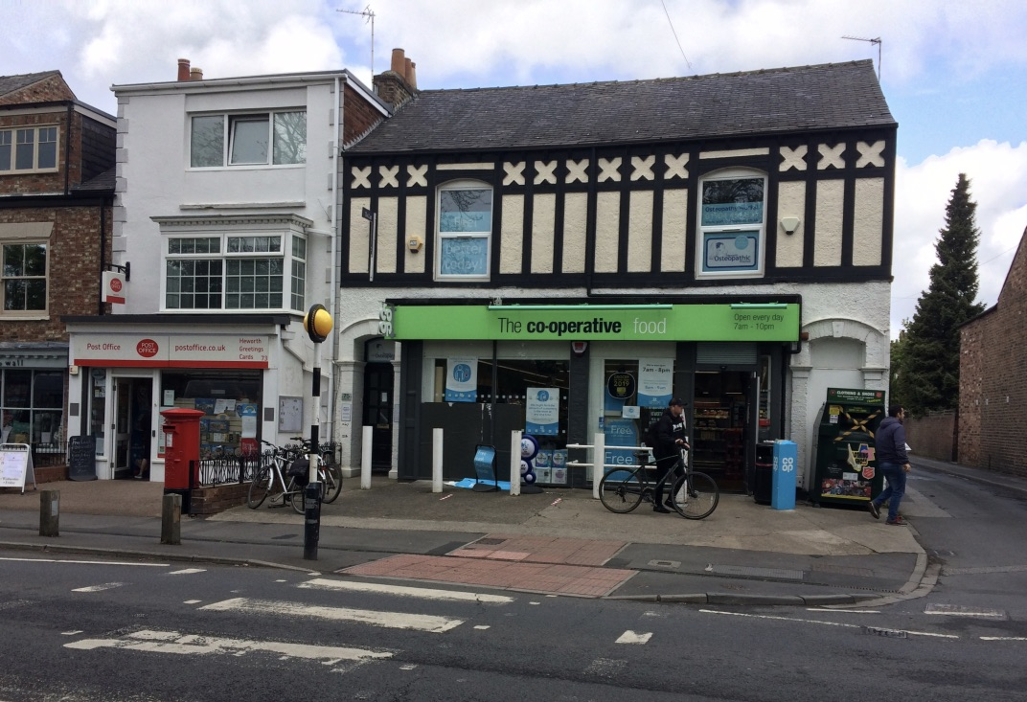
The Changing face of East Parade Co-op
Since opening as a store this has always been the
Cooperative Store
As you can see from the picture top left the property was originally a terraced house
The shop used to have two entrances as shown in the middle top picture with the left hand entrance being for the Coop Butchers
Ruth was a long serving member of staff renowned for always having a pencil behind her ear and totting up the price of shopping by hand

Slide 9
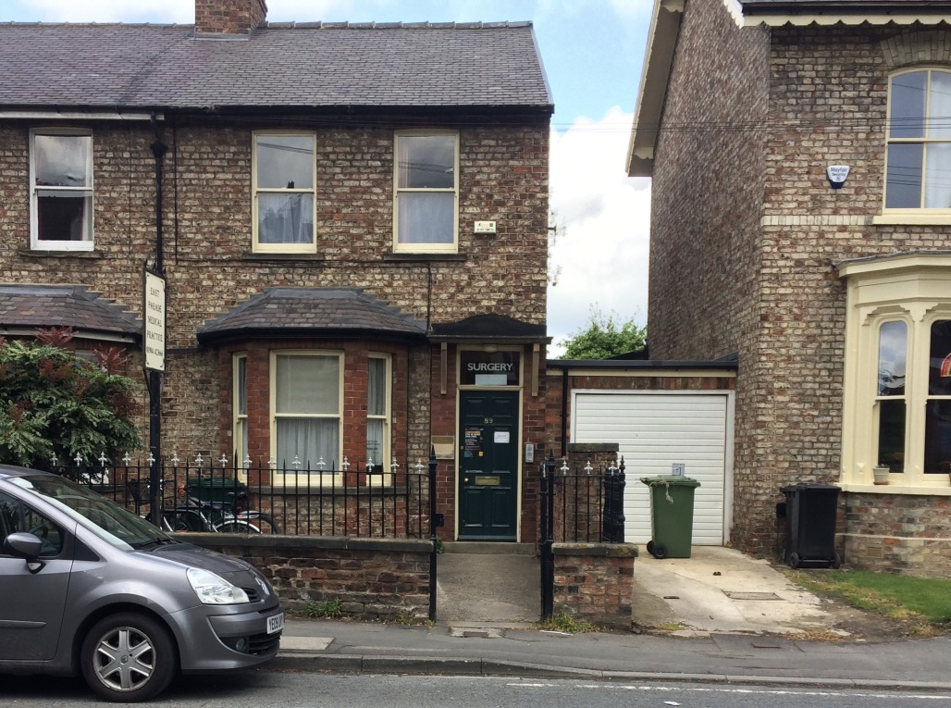
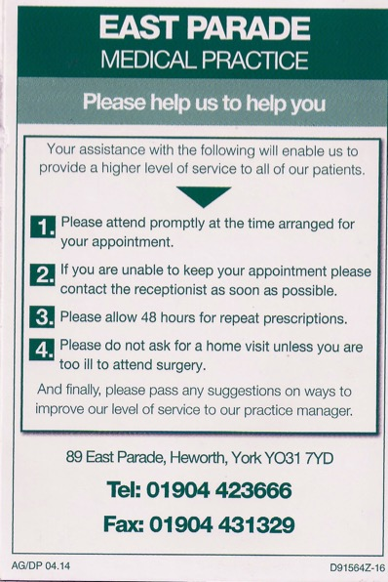
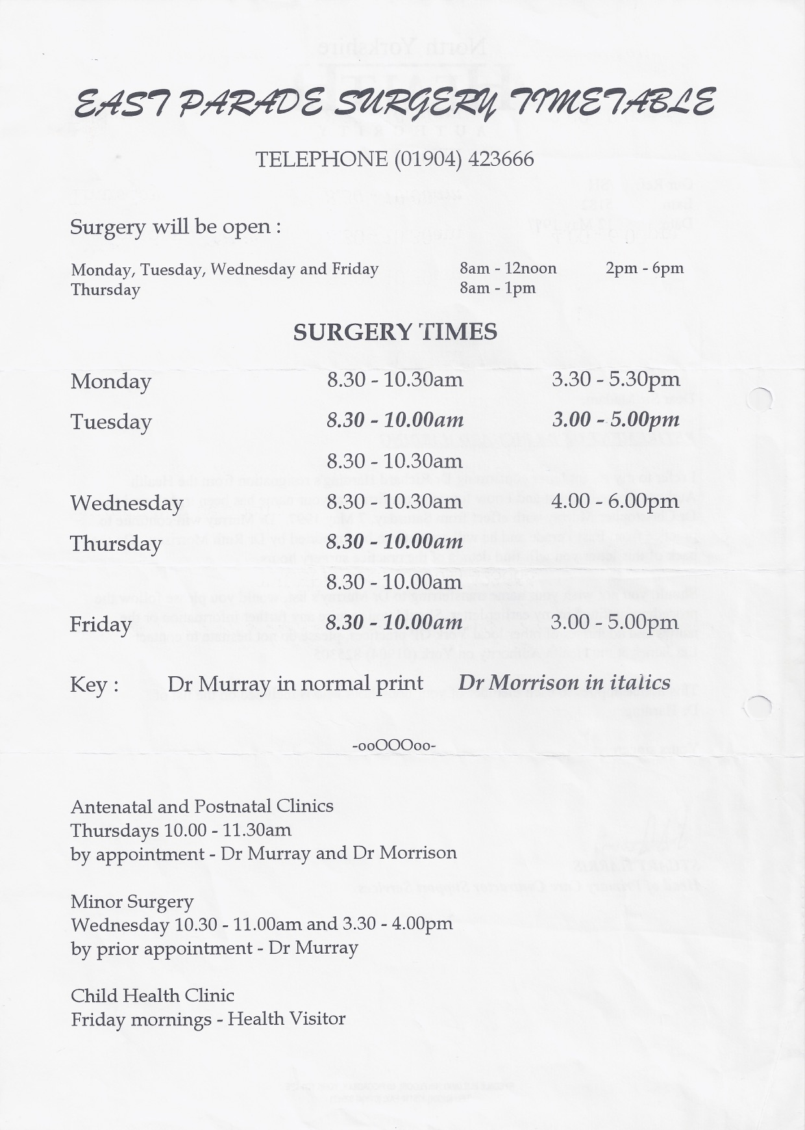
East Parade Medical Practice
The Local Doctors surgery for people from Heworth, it was formerly run for many years by Dr Richard Harding, he retired in 1997 and has been run since by Dr Christopher Murray

Slide 10
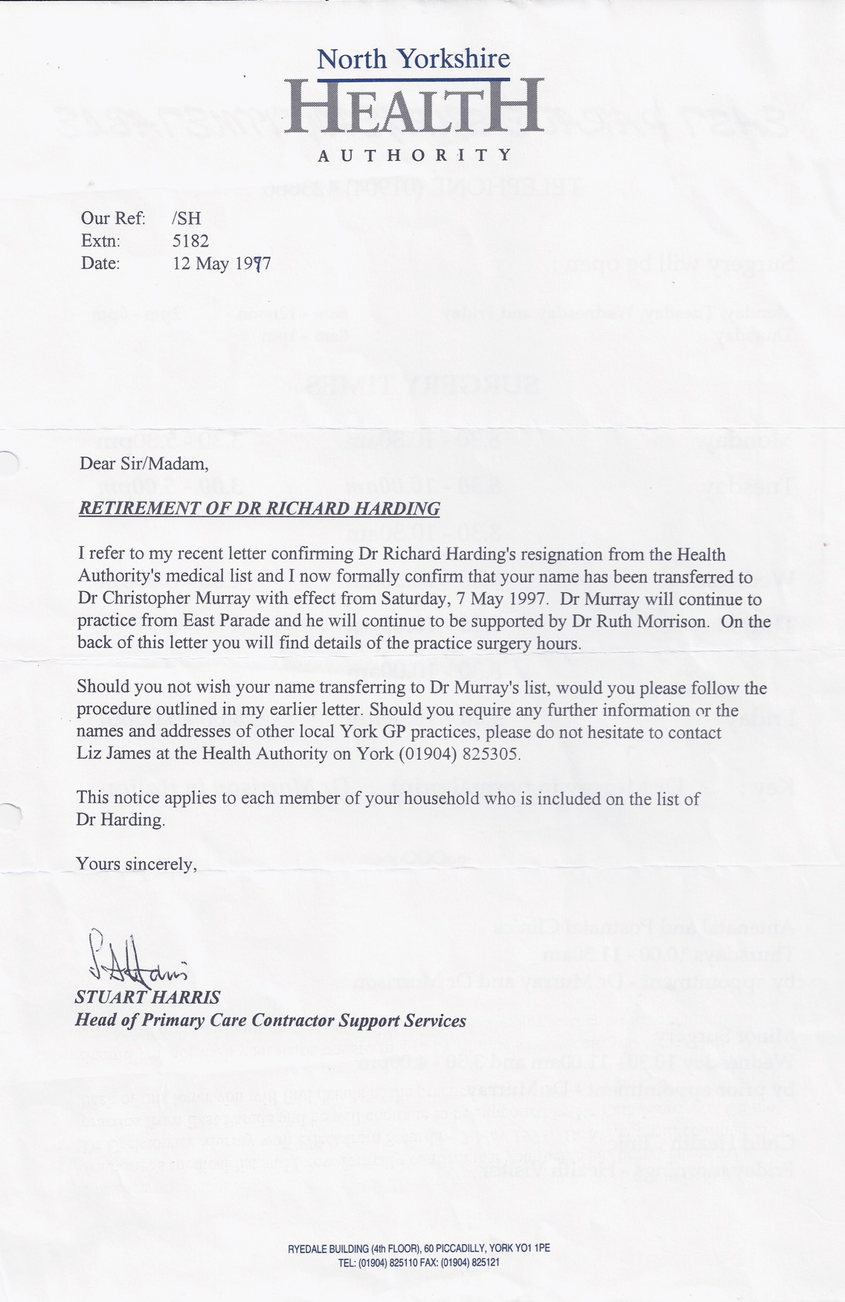
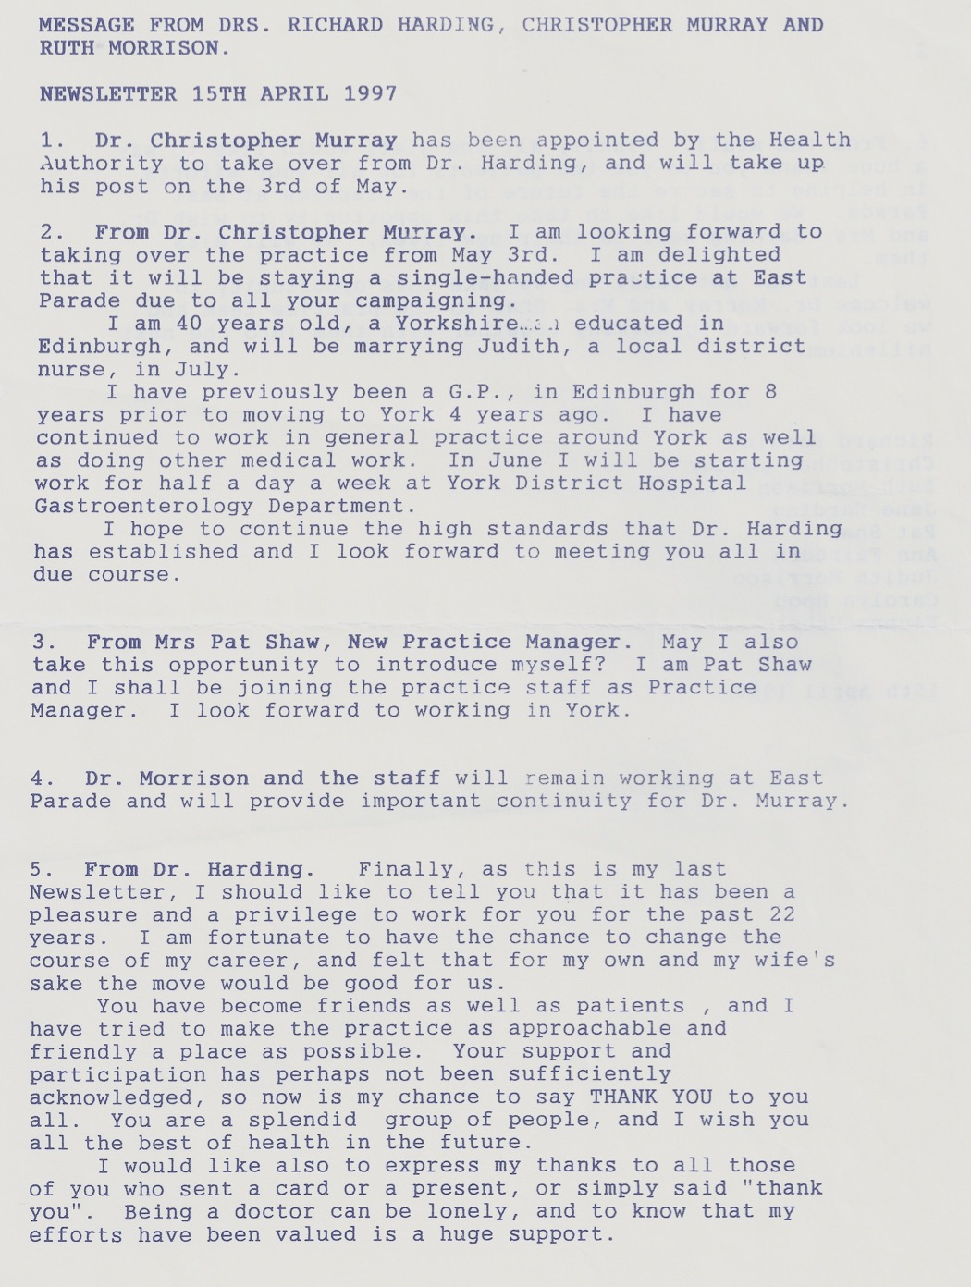
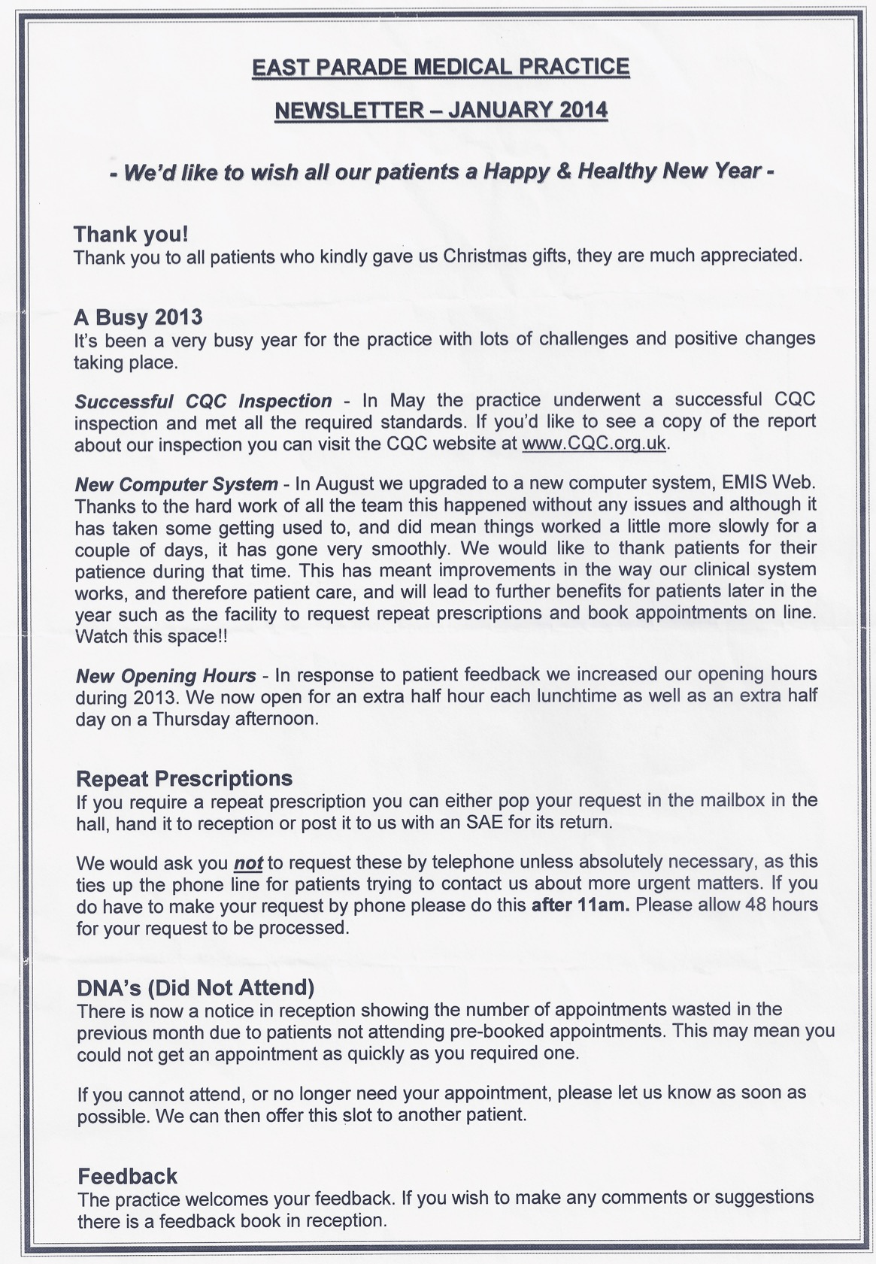
East Parade Medical Practice

Slide 11
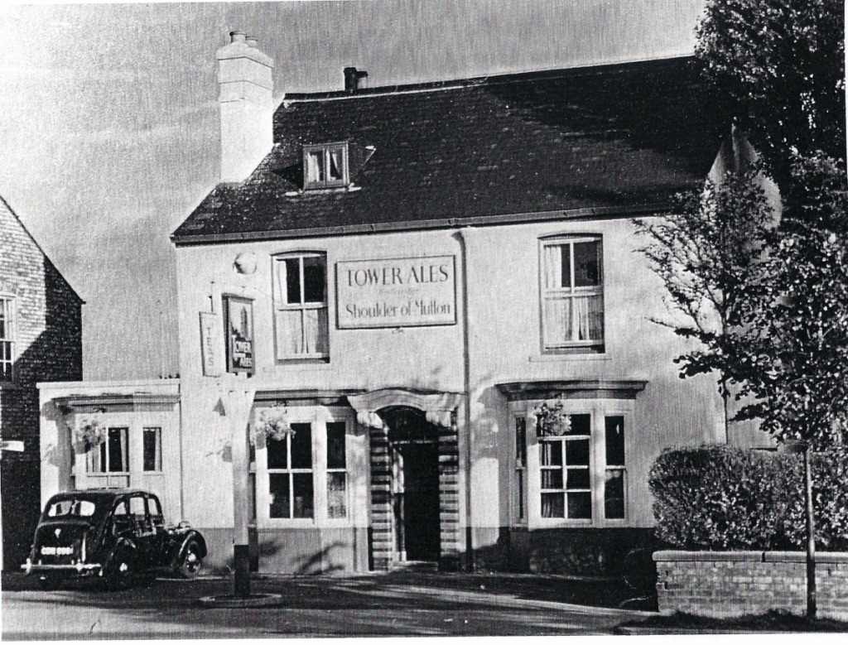
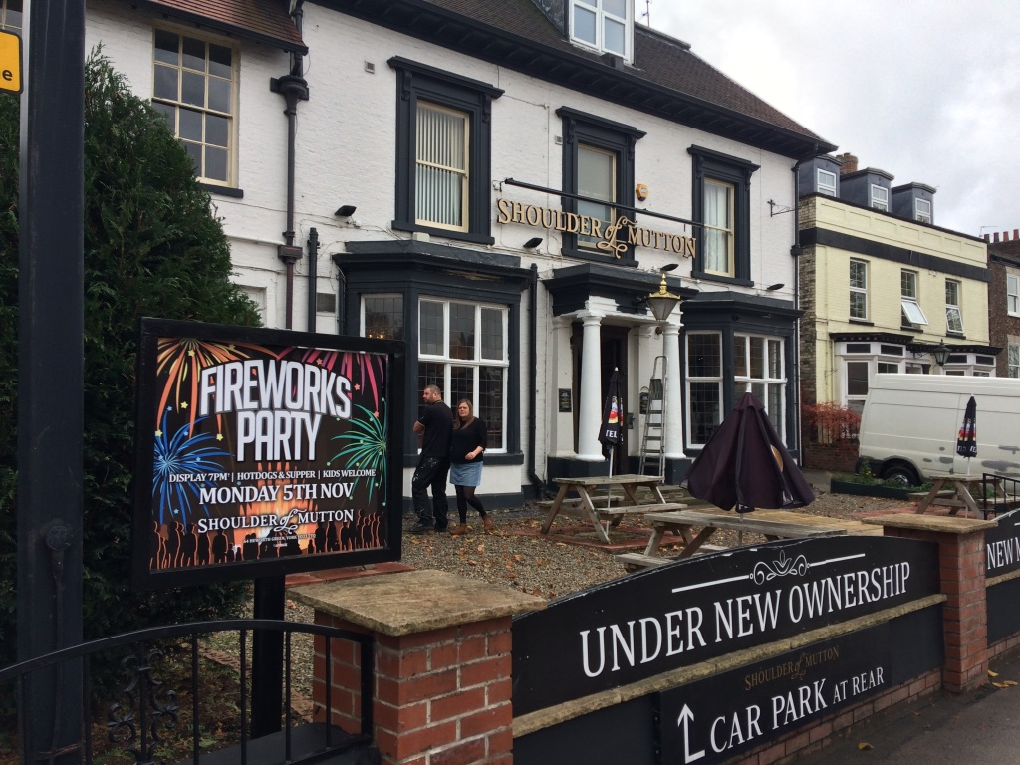
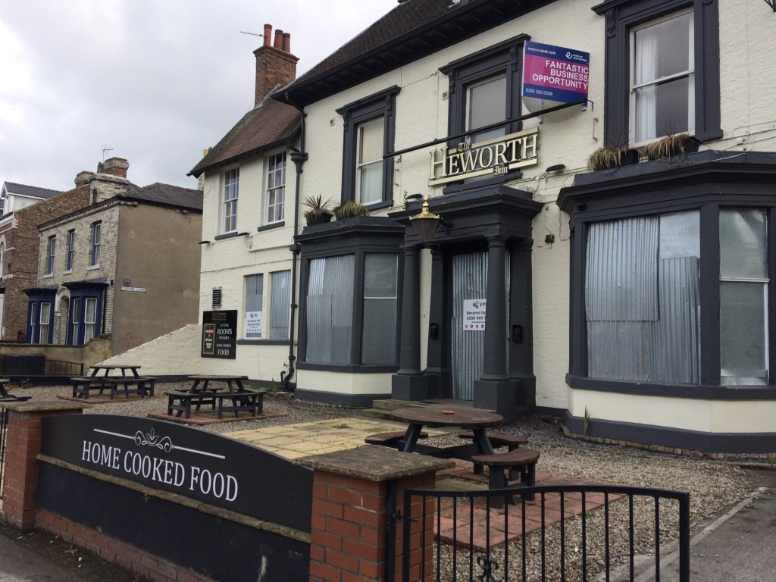
Shoulder of Mutton Inn
Dates back to 1889 and formerly a Doctors Surgery, the site was originally built as a Private residence.
The pub has a chequered history and recently changed its name to the Heworth Inn supposedly to not offend Vegans
The property is yet again boarded up and for sale

Slide 12
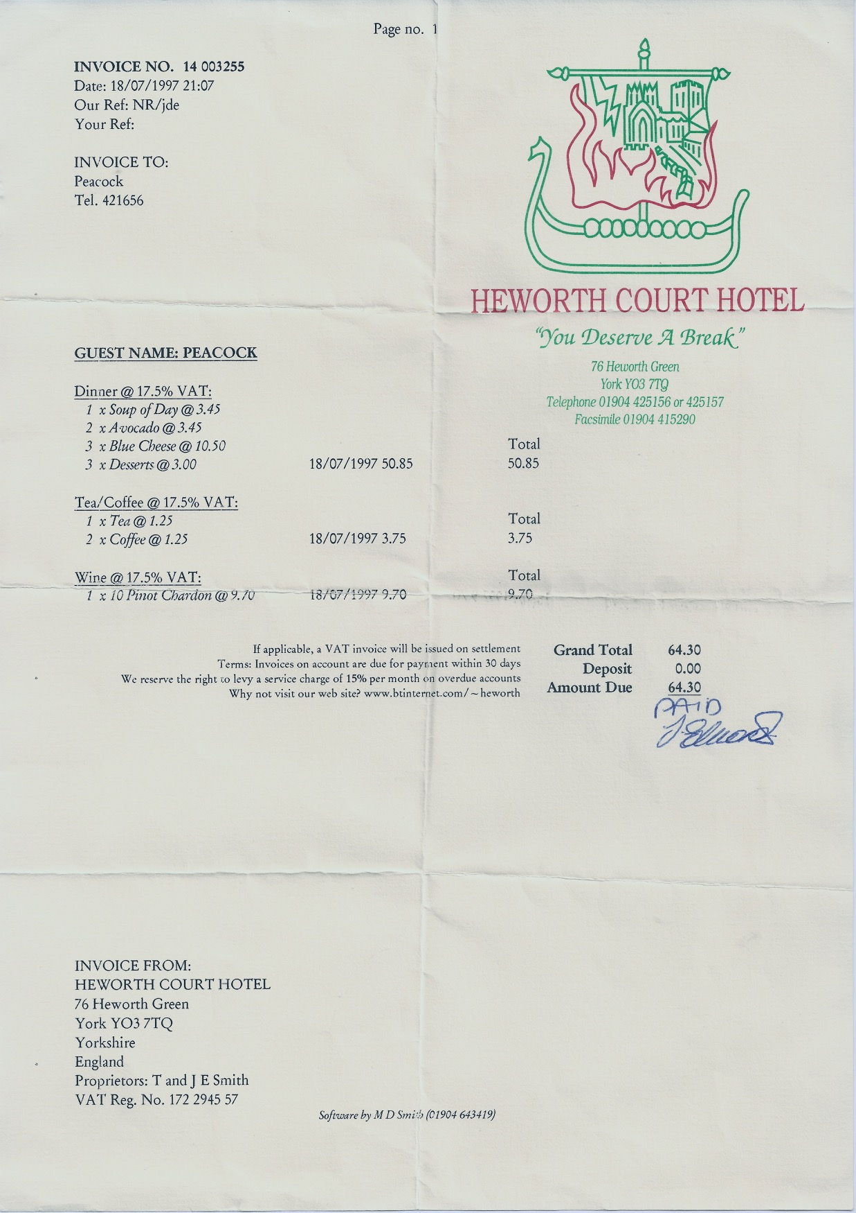
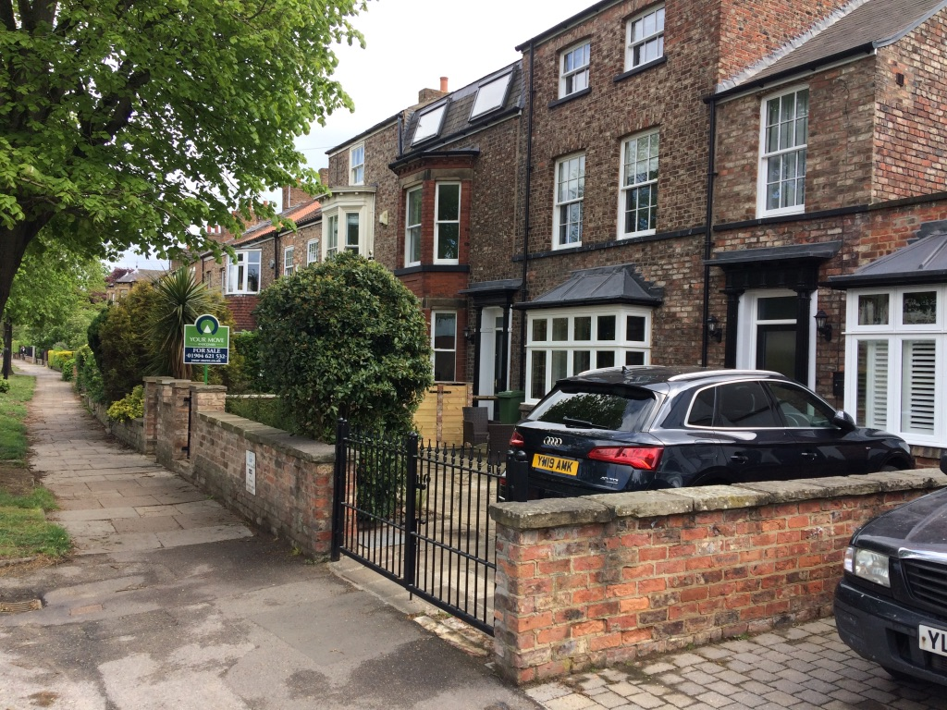
Heworth Court Hotel
Once a very popular Hotel and Restaurant on Heworth Green.
The Hotel closed a few years ago and is now residential premises

Slide 13
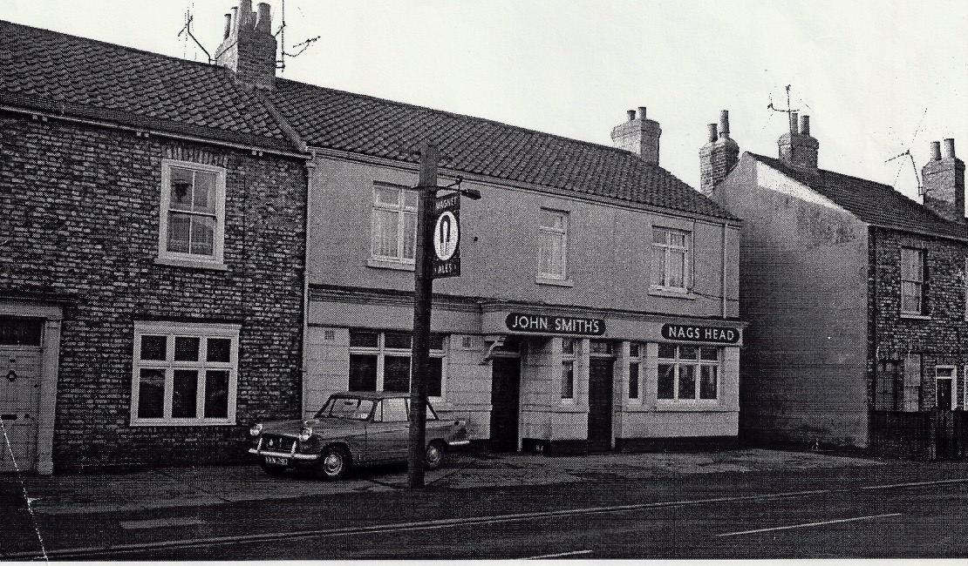
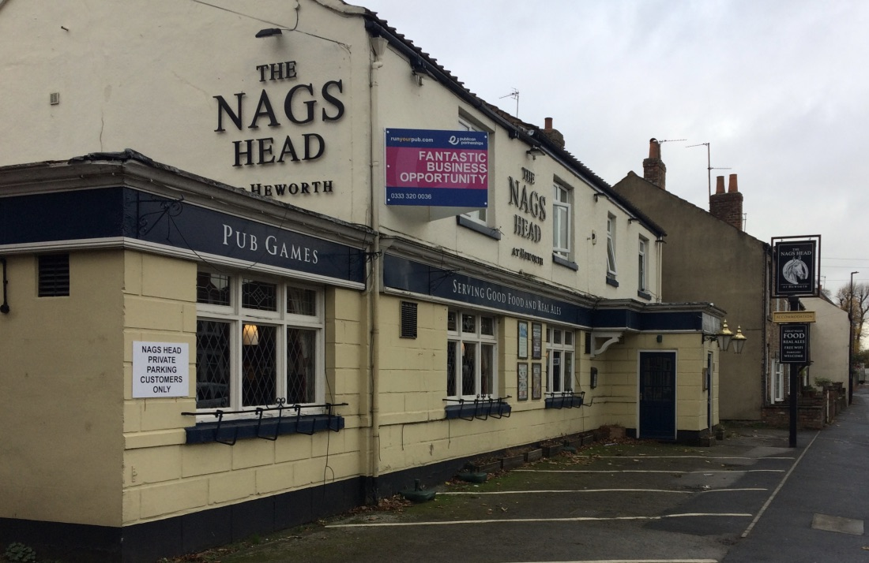
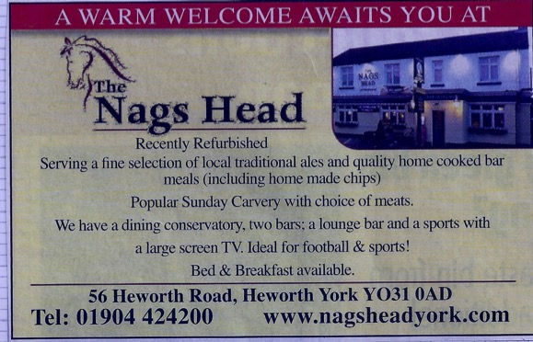
The Nags Head
Built in the second quarter of the 19th Century, the name goes back to at least 1850
Note the older picture and the house on the left which was demolished and became a one storey extension to the pub.
The Nags Head was reportably the local centre for Cock Fighting
The Pub became notable for investigations into the Claudia Laurence investigation over the last few years

Slide 14
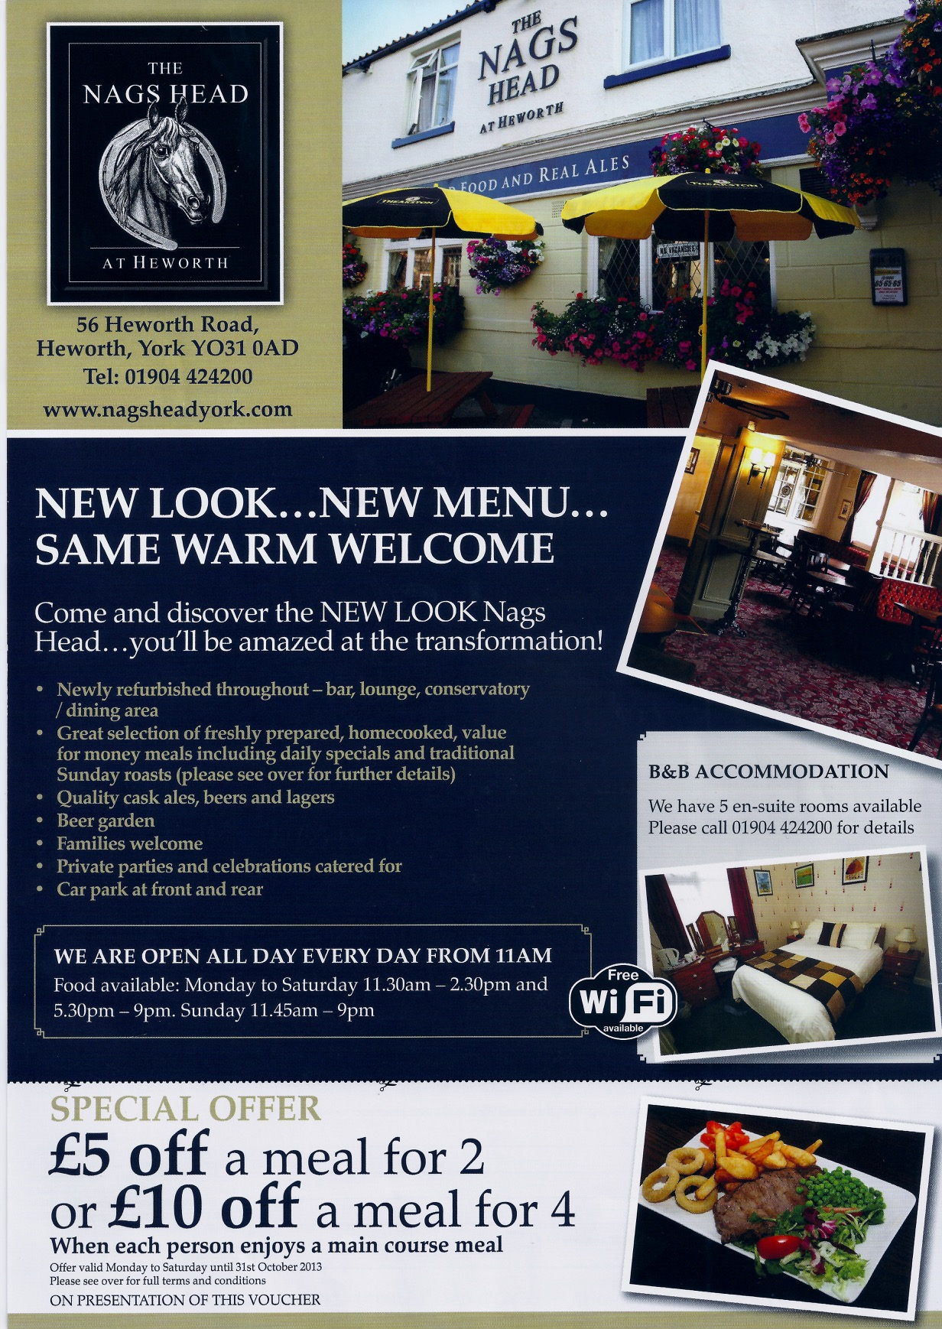
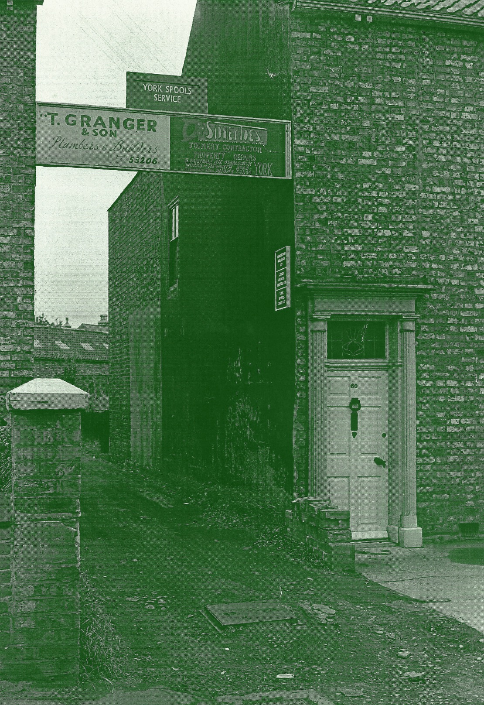
The Nags Head
The side of the Nags Head originally the entrance to Grangers Builders and Toes Joiners

Slide 15
Heworth Road
This was originally Heworth Police Station, it later became the home of Heworth Taxi’s and of late has been a bookmakers shop

Slide 16
Heworth Road
The picture above left shows the Cycle shop on Heworth Road dated around 1958, this later became the popular Hudson’s Butchers which closed in 2005 after 70 years
It is now Spray’s Hairdressers
It is believed the shop on the left of the Cycle shop was originally a bookmakers run by Cocker North

Slide 17
Heworth Road
Quartz travel sadly now closed was an innovative and personal travel booking outlet and gained excellent praise for its way of doing business
Les Lees Drapers shop occupied these premises before Quartz
The shop on the left is Independent living, this may have been a private house before being converted into the shop

Slide 18
Dales Lane Corner
Heworth Place was originally Bowerman's Fish Shop and Grocers, for many years this was known as Friar Tucks
The current Cost Cutter store was originally Doherty’s confectioners, it later became a Launderette, Video and Sweet Shop

Slide 19
1 to 5 Heworth Village
Left to right Number 1 was originally Walter Willsons grocers store, it later became a charity shop supporting St Leonard's Hospice, Turn Back Time opened in 2018
Number 3 was originally Wakefield's Greengrocers for many years, it late became Mair's Deli run by Eric and his Wife, it is now called Number 3 and operates as a Deli and Café
The chemist shop was yet another of F W Woods shops taken over by Boots

Slide 20
Heworth Village Florist
Delightful little Florist shop in Heworth Village, sadly this is now closed and has reverted to a terrace property

Slide 21
Heworth Village
The Walnut Tree above was built as a private residence. The Britannia Inn which is opposite was the original pub in Heworth Village, the house is owned by Mr. & Mrs. Evans who owned the Launderette on the corner of Dales Lane
The Walnut Tree only opened as a pub when the licence was transferred from the Britannia

Slide 22
Heworth Village
Clock House Dental Surgery on Heworth Village, it originally moved here some years ago, this was originally Sorrel’s Builders Yard
Chapmans Garage has been a long standing business on the site

Slide 23
Stockton Lane Garage

Slide 24
Food Salvage Wagons
Early recycling from World War Two and just after, run by the corporation, these pictures are in Walney Road, on the picture on the right you can see the original Tang Hall Hotel in the background. People would save Food scraps and peelings for Collection

Slide 25
Miscellaneous
A few examples of other business’s in the area, Heworth Nurseries originally occupied land where Lime & Chestnut Avenue are
The Clinic above was originally a Nursery for Children and the building on the left was the Driving Test Centre
The advert for Walkers is from the York Gazette in 1885

