Slide 1
The Tang Hall Local History Group Presents
Looking Back at
Heworth & Tang Hall

Slide 2
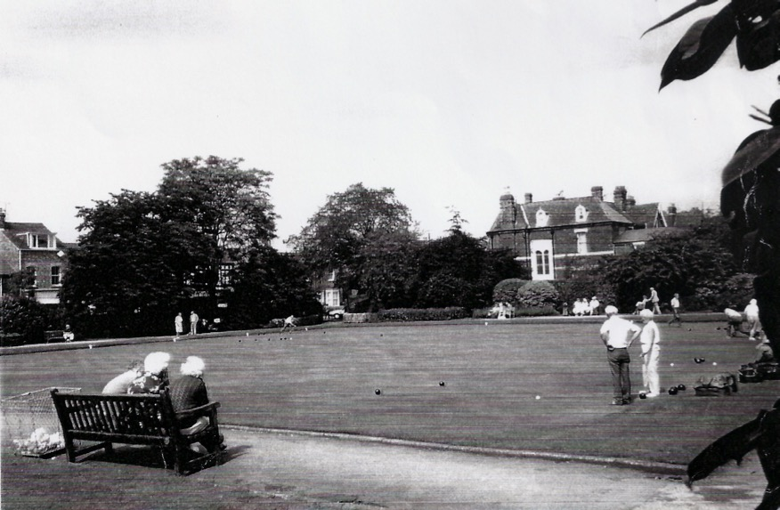
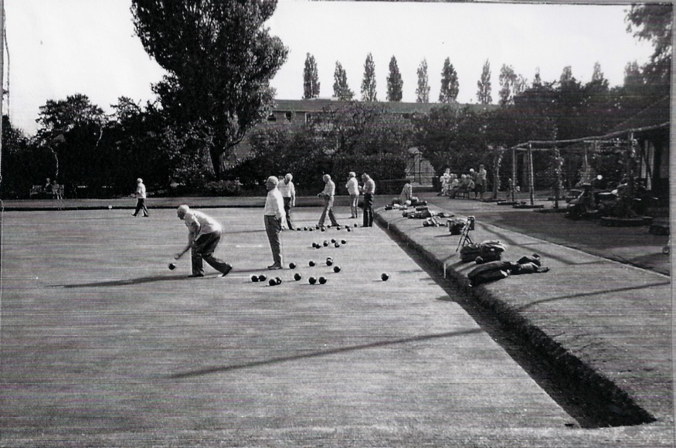
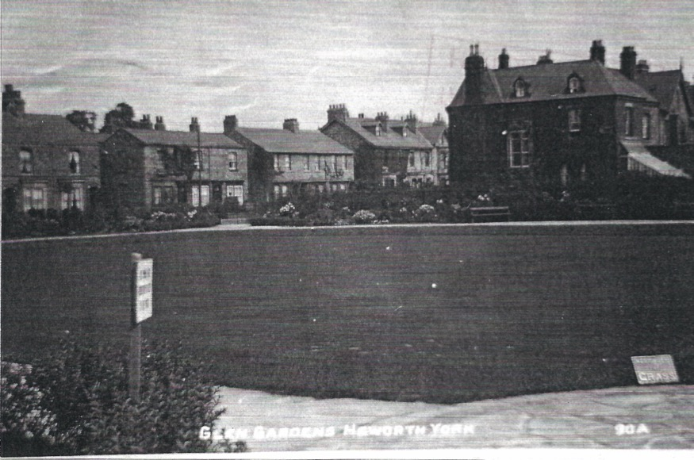
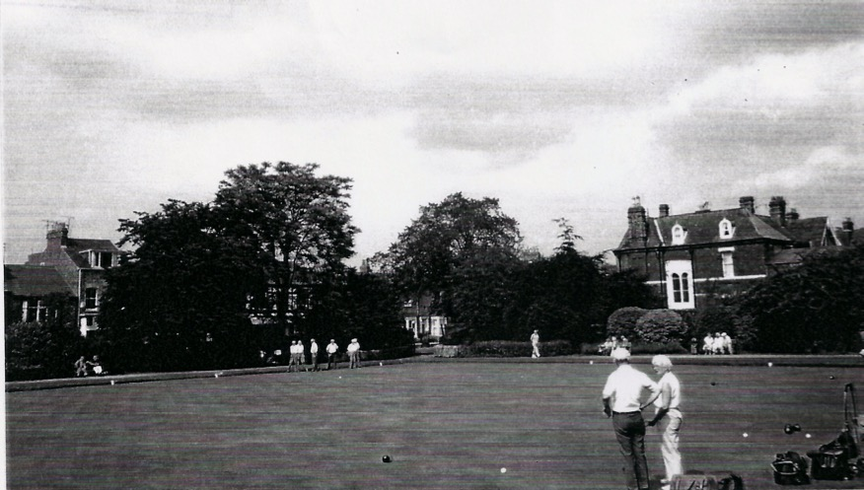
Glen Gardens
Located off East Parade in Heworth, these Gardens were part of the former Glen Estate
The site can be found on OS maps dating back to 1852
It was opened in June 1915 by the then Lord Mayor J B Morell
There was always a children’s play area here and new swings and sides were added in the 1980’s

Slide 3
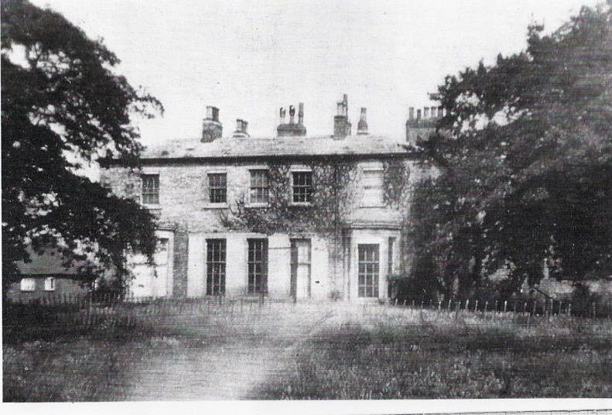
Heworth Hall
With 11 bedrooms, Heworth Hall was one of the largest villa’s that sprung up in Heworth following the enclosure awards in the early 19th century
Built in about 1830 by Mrs. Lucy Willey and her husband Jocelyn, curate of St Cuthbert's
The house was a conservative classical style.
In 1859 Lady Milburn lived there and later in the closing years of the century it was occupied by Thomas Brogden
In 1928 the house and its 12 acres of grounds were sold by auction
New semi detached houses were built and gradually advanced up the drive.
The house was eventually demolished in 1934

Slide 4
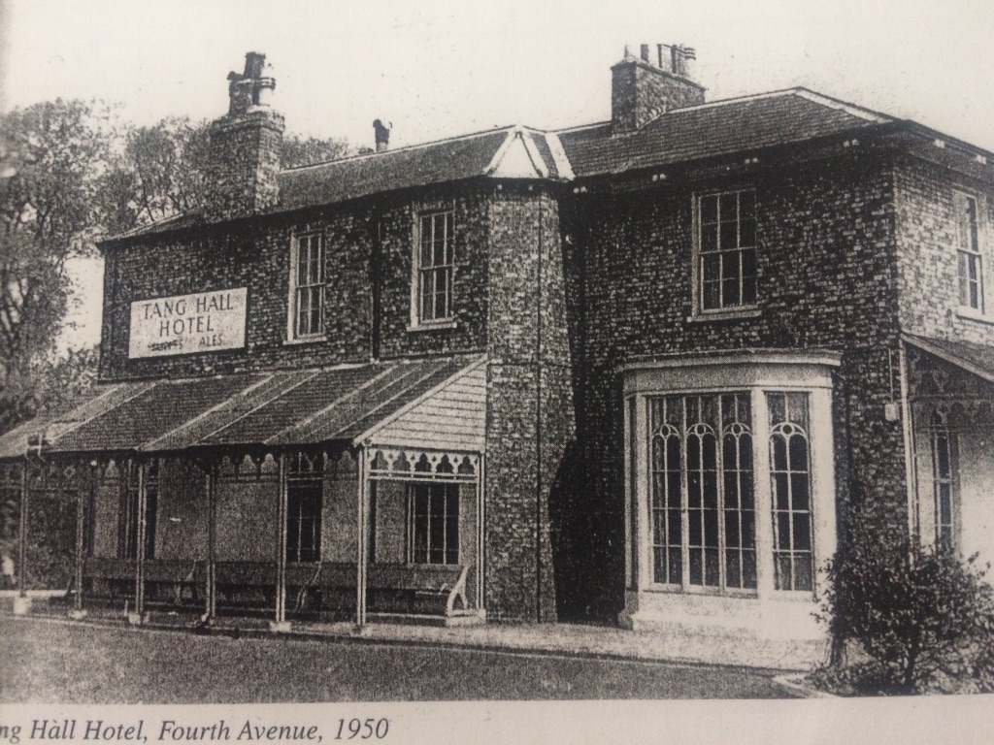
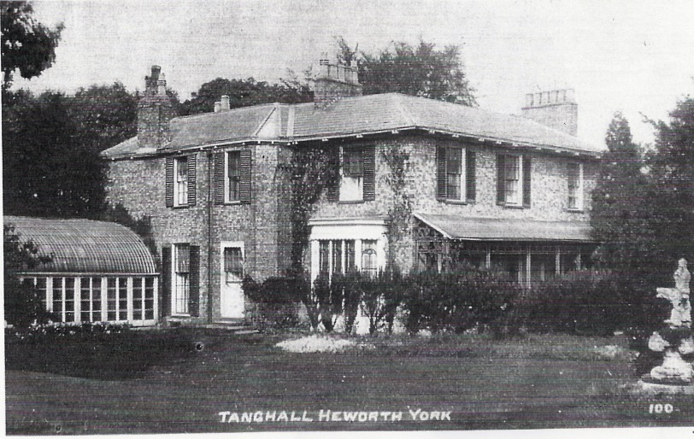
The Tang Hall
The Tang Hall was first mentioned in the 13th Century however it was James Barbers house of 1830 that elevated it to the status of a gentleman's villa. Typical of York it had deep overhanging eaves which suggests that Atkinsons were the architects.
James Barber a Silversmith and Coach House owner from Coney Street sold the property and estate to Captain Edward and Lady Starkey, Starkey sadly died following a coach crash near the minster but his wife Evelyn living there until old age, she was known for shooting trespassers with grapeshot. Evelyn died in 1925 and the estate was purchased by York Corporation with the land developed for housing as part of the Tang Hall Estate. The house survived and was run as a pub with leisure gardens. The original house was demolished and replaced by a modern public house however this in turn was demolished in the 1980’s and replaced by a housing.

Slide 5
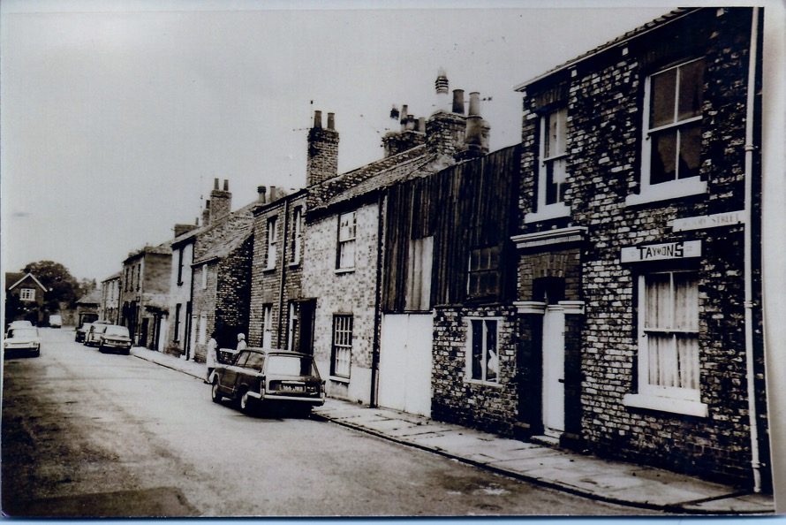
Wood Street
Wood Street looking towards Heworth Green, the street runs from the behind the Co-op on East Parade and links to Heworth Green.
The Kidd family lived at the far right of the photograph and there was a gate down the side of the house which led to an orchard.
The whole area here was demolished and replaced with Council properties

Slide 6
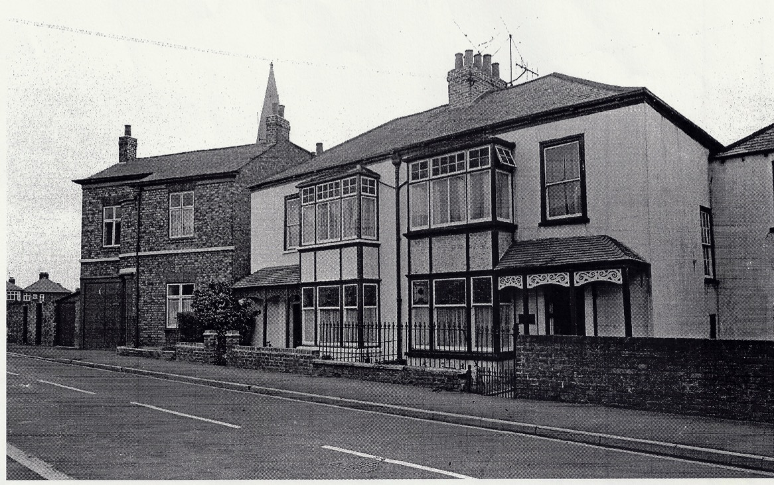
Pear Tree Cottage
Pear Tree Cottage on Heworth Road on the right hand side looking towards the Church
The property dates back to 1831 though this photograph dates from much later judging by the old fashioned television aerial on the roof

Slide 7
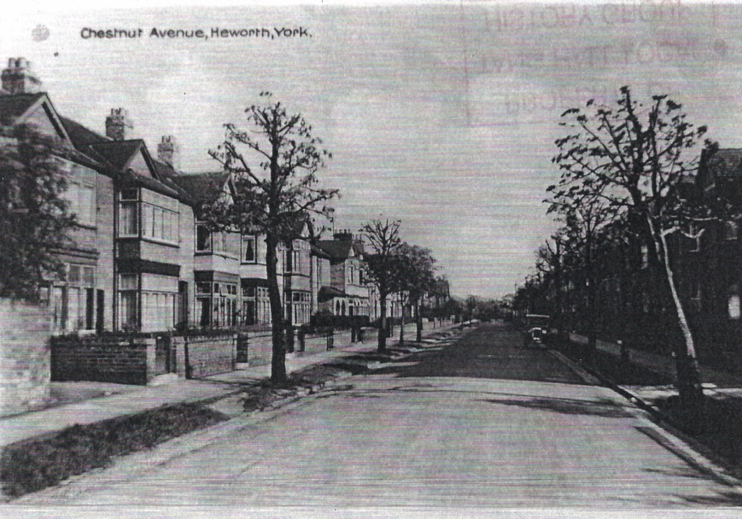
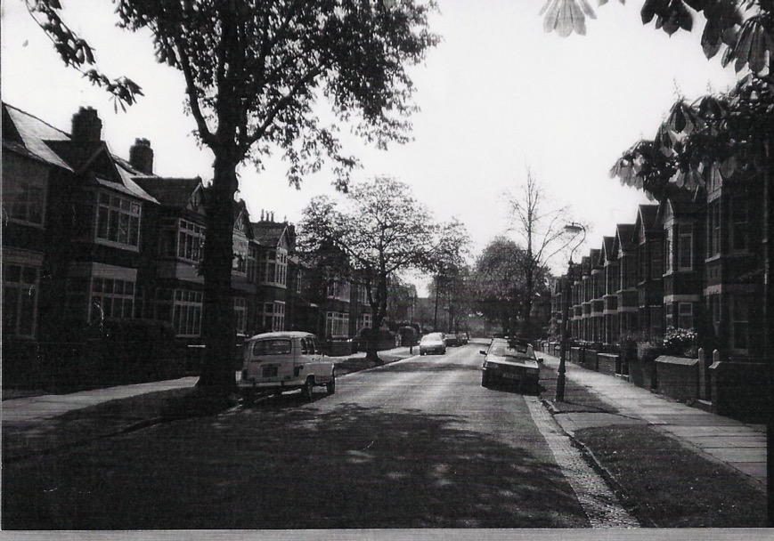
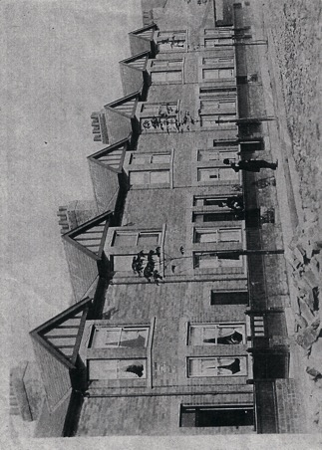
Chestnut Avenue
Chestnut Avenue was built in 1905, it was developed by two York Solicitors Peters and Martin. At time of construction none of the properties had garages as there was no demand for these at the time.
Mrs. V Hunter ran the prep school here in the 1930’s

Slide 8
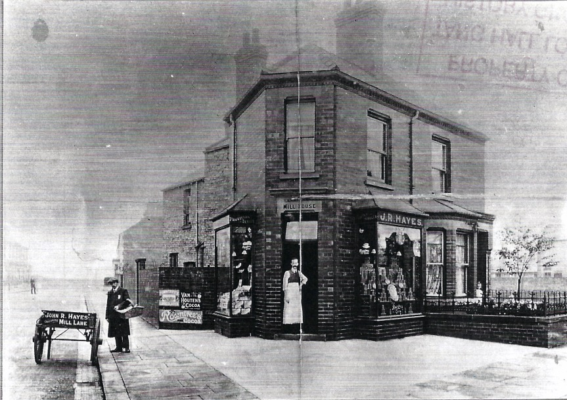
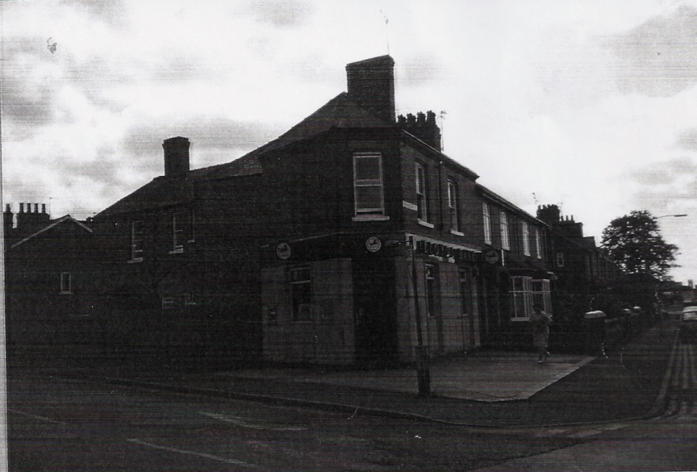
Harcourt Street Corner

Slide 9
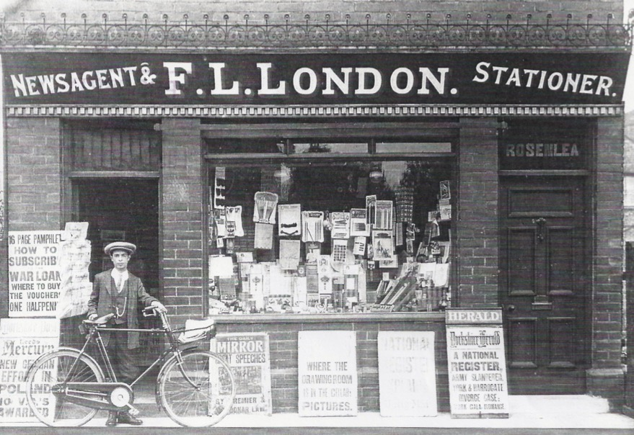
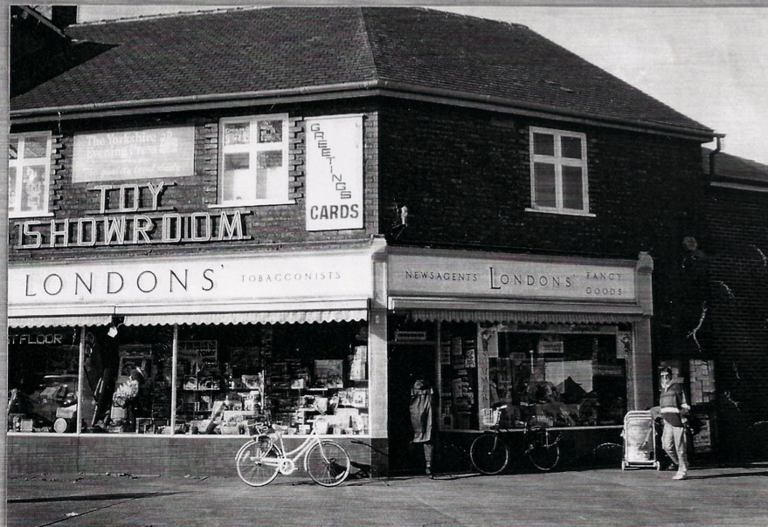
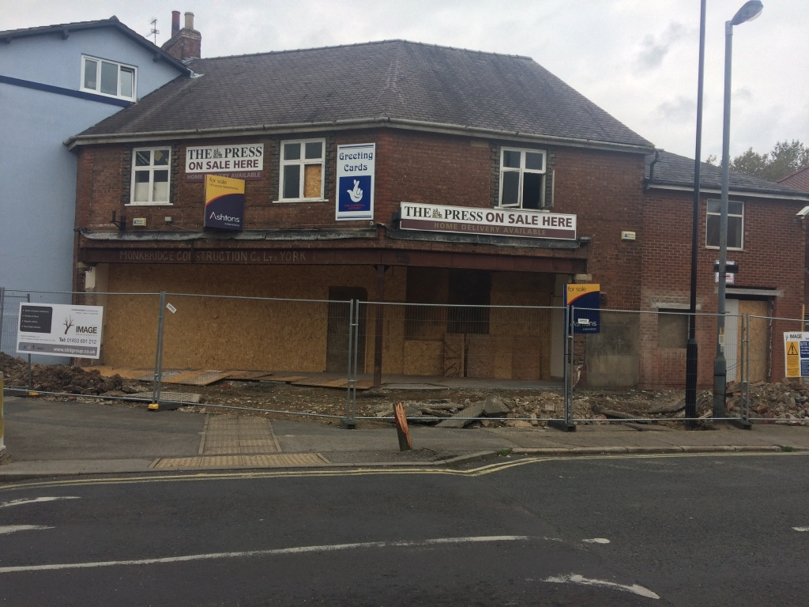
London’s
The original London’s shop was opened in the first world war, the bigger premises on the corner of Mill Lane were opened in the 1930’s
The photograph bottom left shows the demolition starting after the shop closed, it is now flats

Slide 10
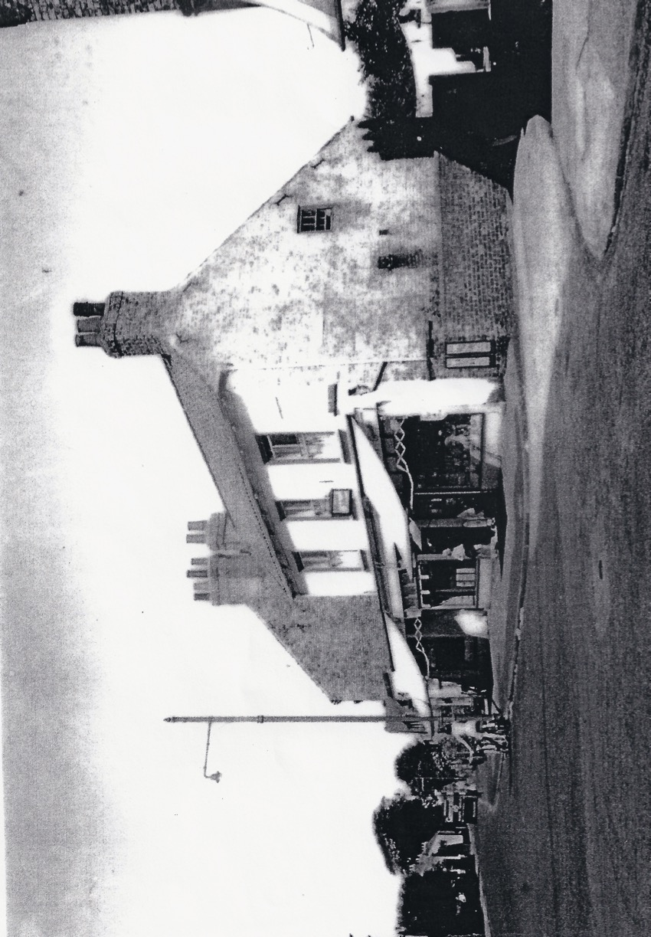
Dales Lane Corner
Pictured around 1959 and with virtually no traffic
Notice the lack of traffic lights and street signs

Slide 11
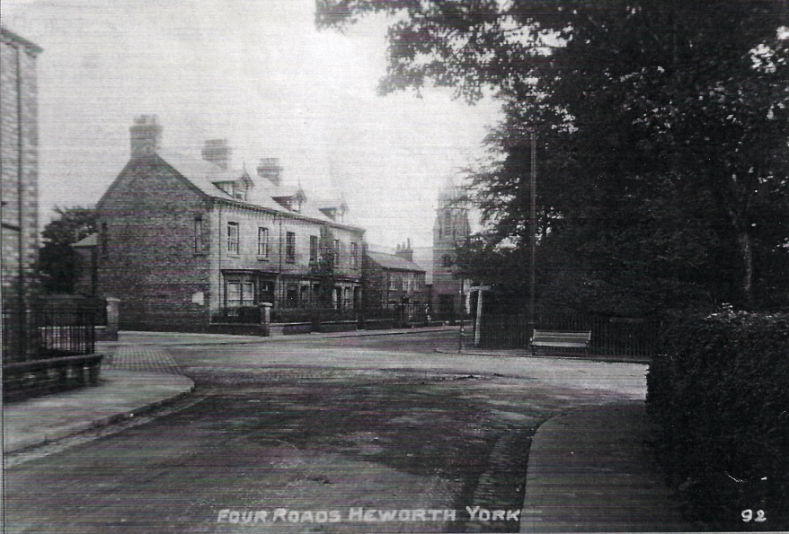
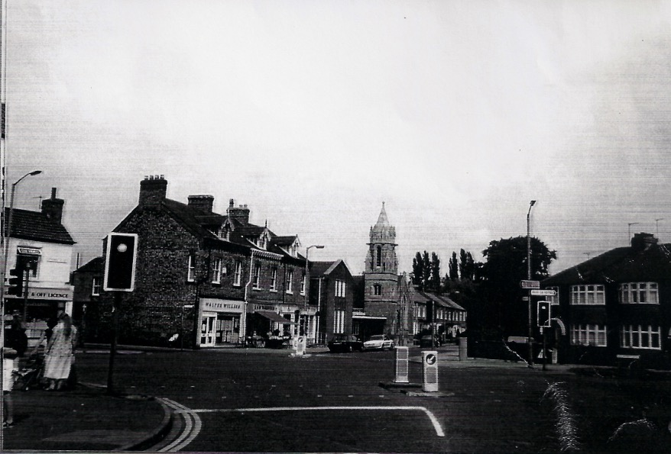
Heworth Church Crossroads
Two views looking towards Heworth Village, the one of the left is circa 1935, it gives a totally peaceful aura of a small village.
The photograph on the right taken in 1980 shows the introduction of traffic lights and bollards in the road and a gradual widening of the road
More recently following a revamp of the junction the bollards were removed but the lights remain

Slide 12
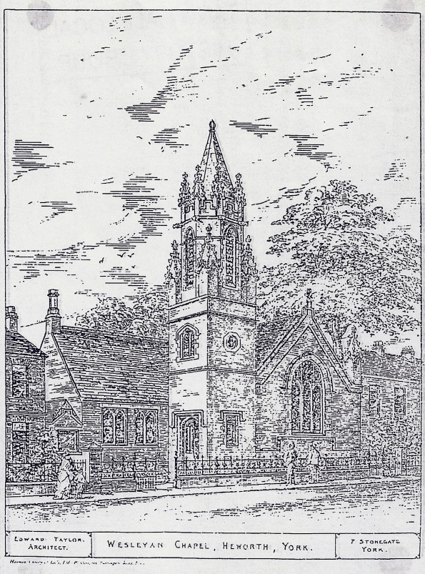
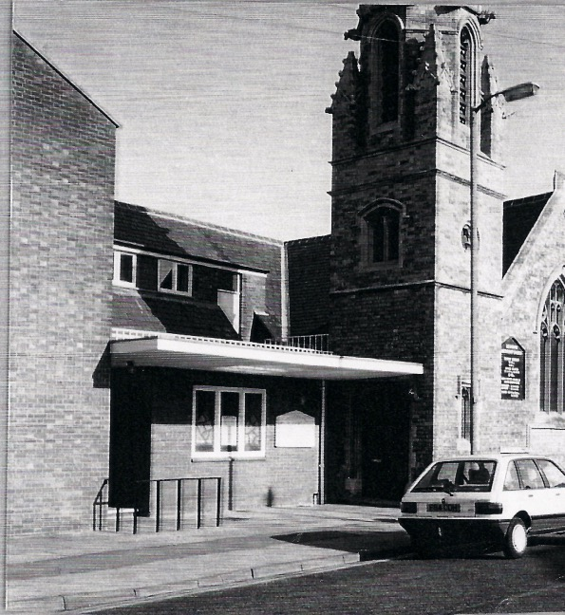
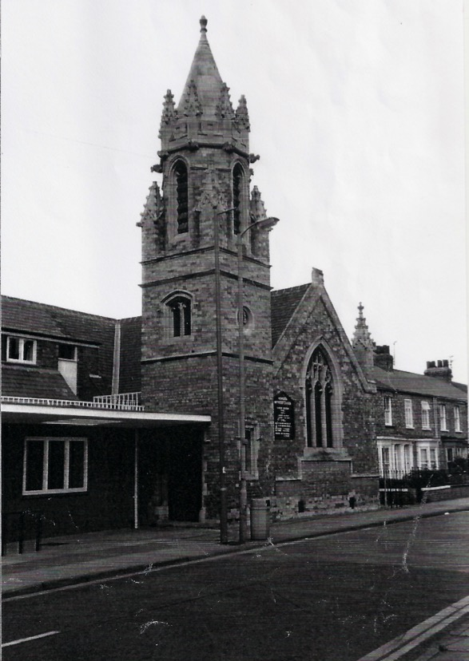
Heworth Methodist Church
A Wesleyan Methodist chapel was built at Heworth in 1826. It remained in use until 1889 when it was demolished and replaced by a new and larger chapel and schoolroom on the adjacent site of Heworth House. The new chapel, which opened in 1890, was largely funded by the gift of Hannah Crampton Leak in memory of her late husband, William, a prominent York Methodist.
The building was designed by Edward Taylor in gothic style and could seat 220 people. A Sunday School was set up by William Camidge soon after the new chapel opened and a new schoolroom was later added in 1930 to accommodate a growing congregation as Heworth underwent a period of significant expansion. By the 1930s the Chapel also had a choir, a Wesley Guild and a Women's Meeting.

Slide 13
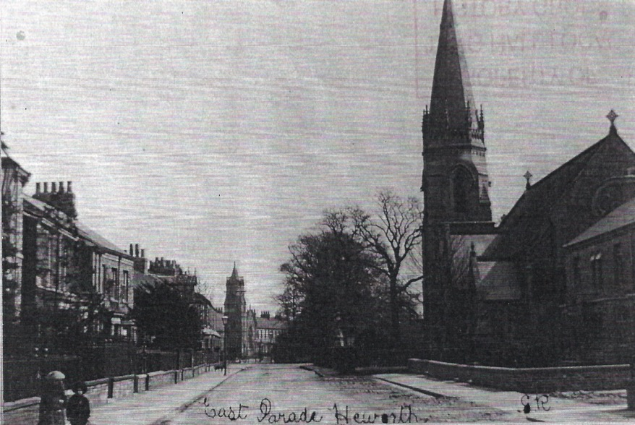
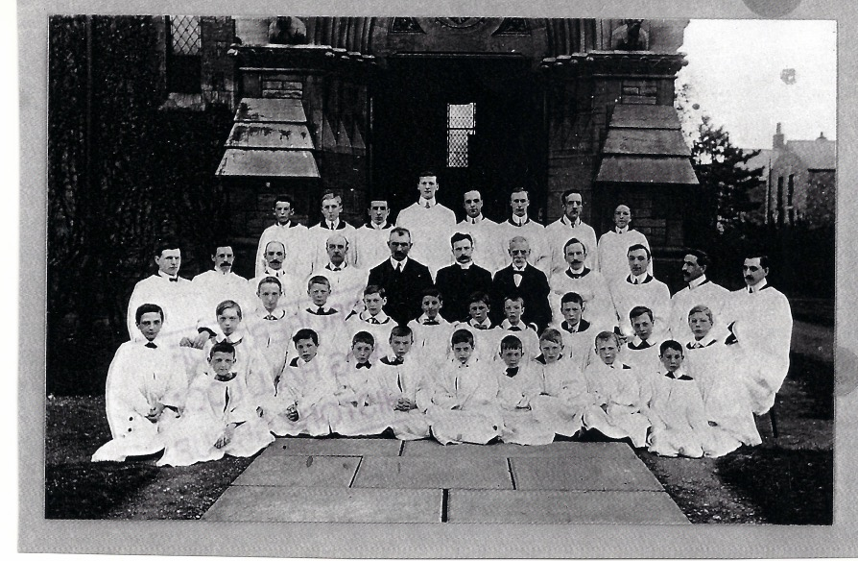
Holy Trinity Church
1870-
The church of Holy Trinity, Heworth was consecrated in 1869, and 1870 separated from the parish of York, St Saviour in 1870 to form the modern parish of York, Holy Trinity Heworth.
In 1936 parts of Huntington, Osbaldwick and York, St Cuthbert were added to the parish., and a mission chapel in the western part of the parish was dedicated to St Wulfstan in 1941. The parish also included Christ Church on Stockton Lane from 1964 until 1998 when it separated to form an independent parish.
The church is built in the Early English style by architect George Fowler Jones and contains a large wooden reredos made in the Bavarian town of Oberammergau.

Slide 14
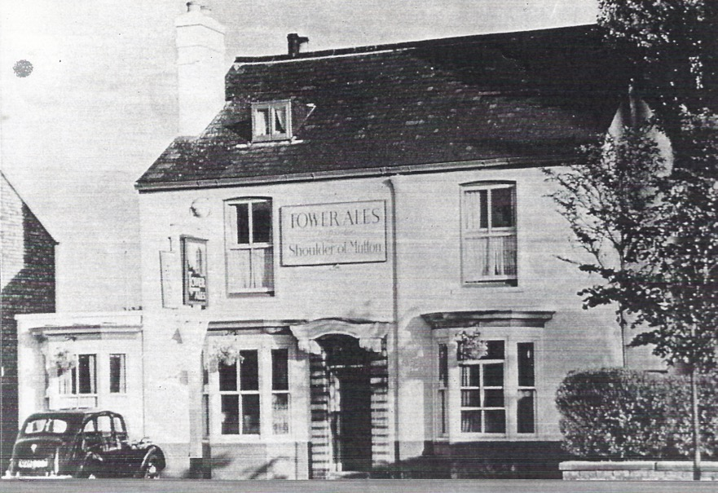
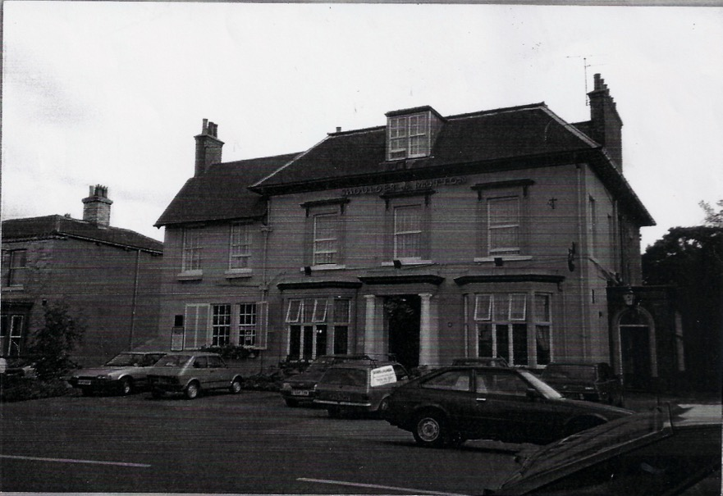
Shoulder of Mutton Inn

Slide 15
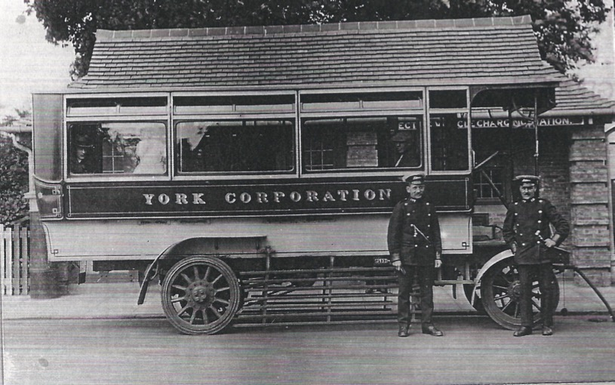
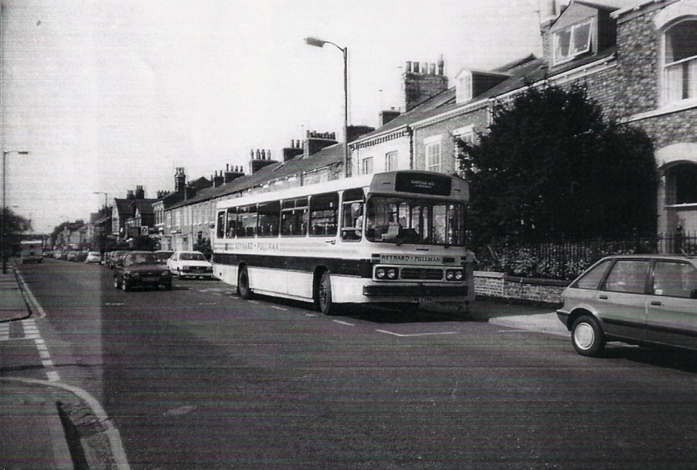
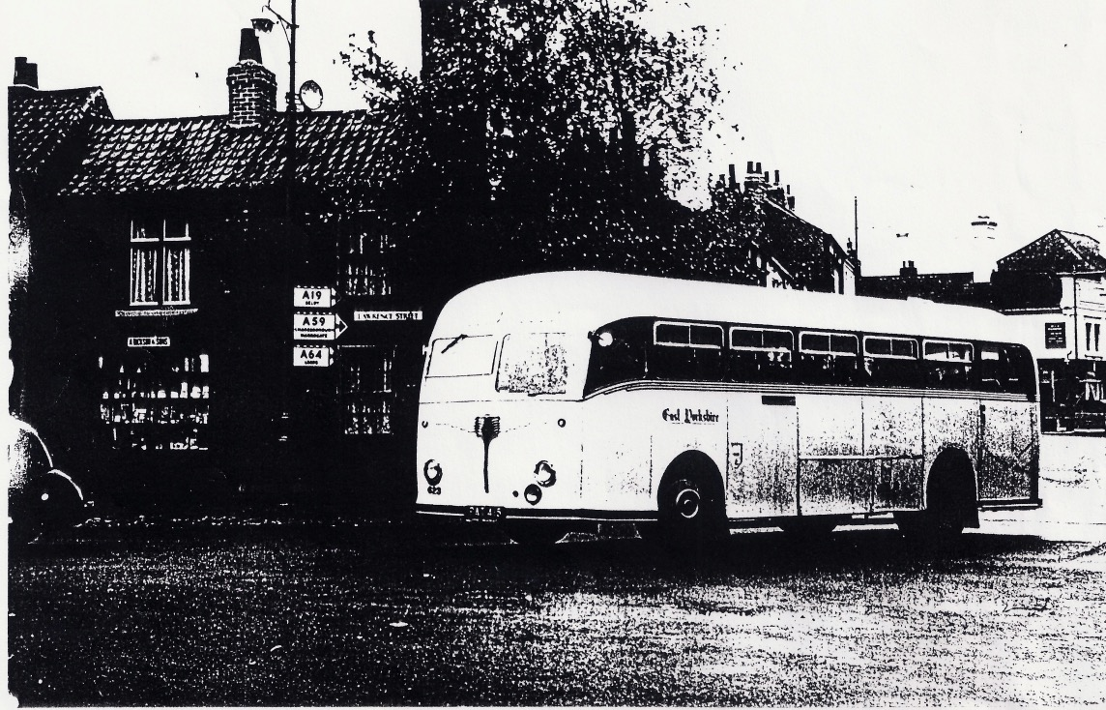
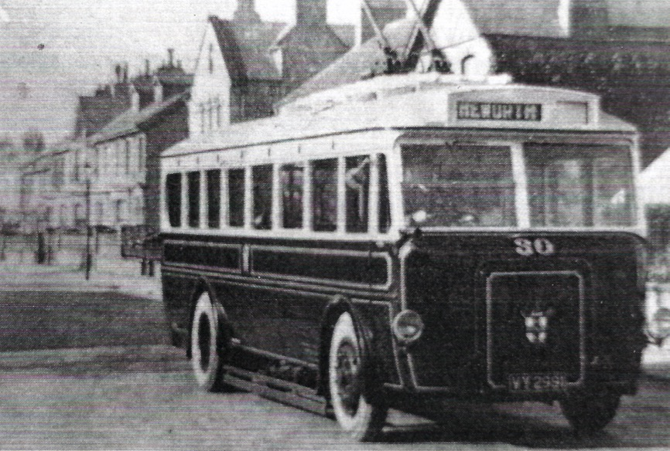
Public Transport
Top left what is now the flower shop at the bottom of Monk Stray was originally the bus terminus and charging point
Top Right a more modern passenger bus in East Parade
Bottom left and old East Yorkshire motor services coach turning into Lawrence Street
Bottom right a Trolley Bus running down East Parade

Slide 16
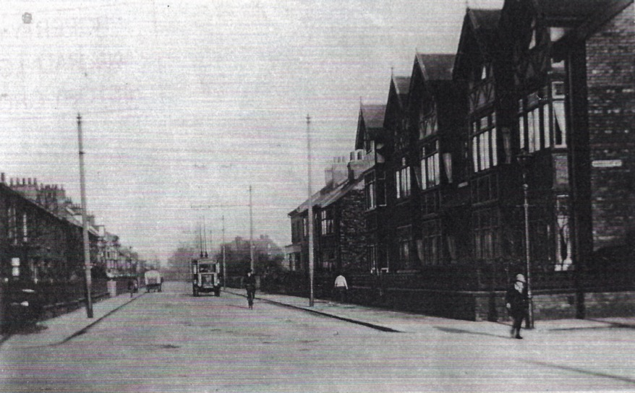
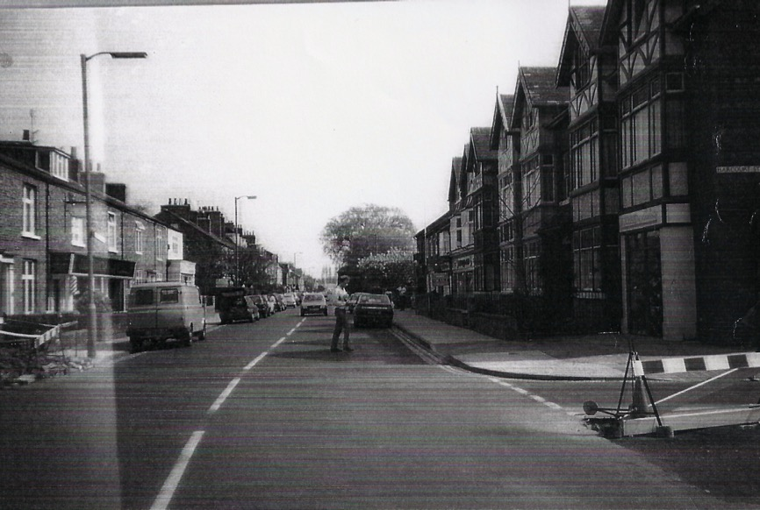
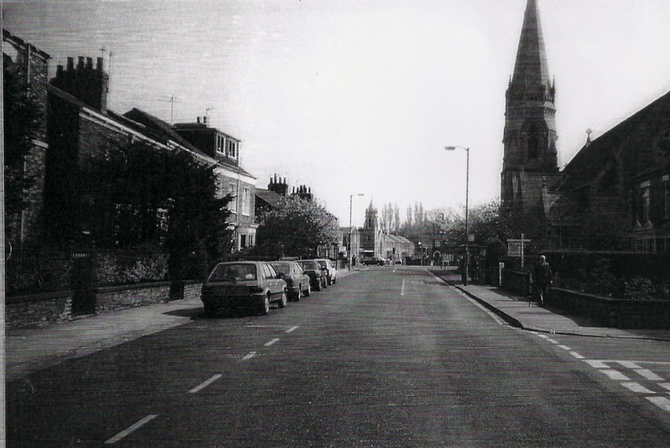
Views of East Parade

Slide 17
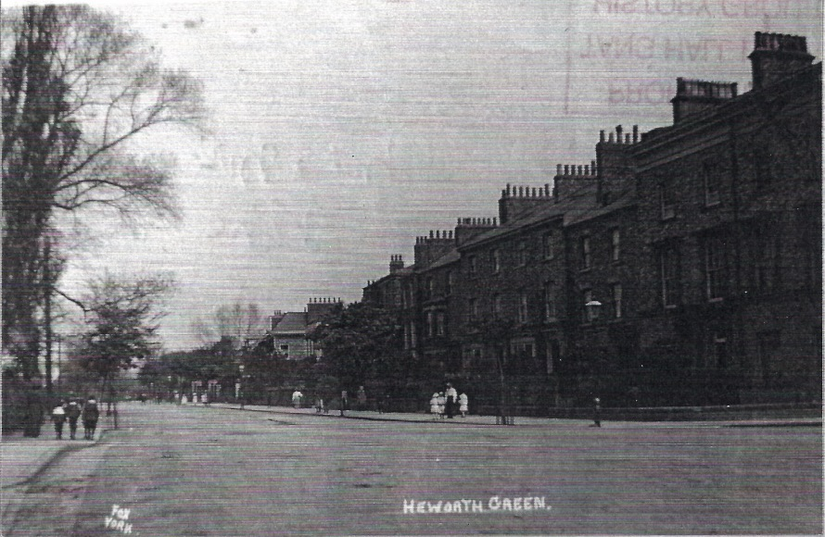
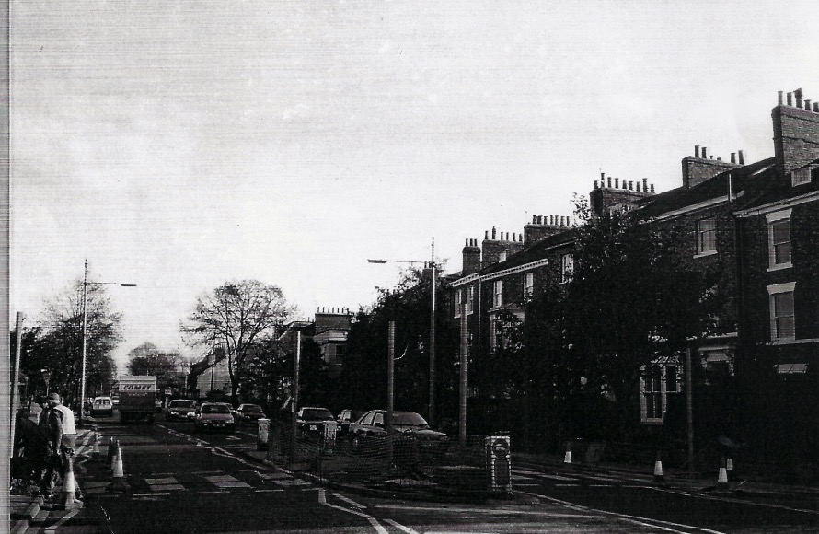
Heworth Green

Slide 18
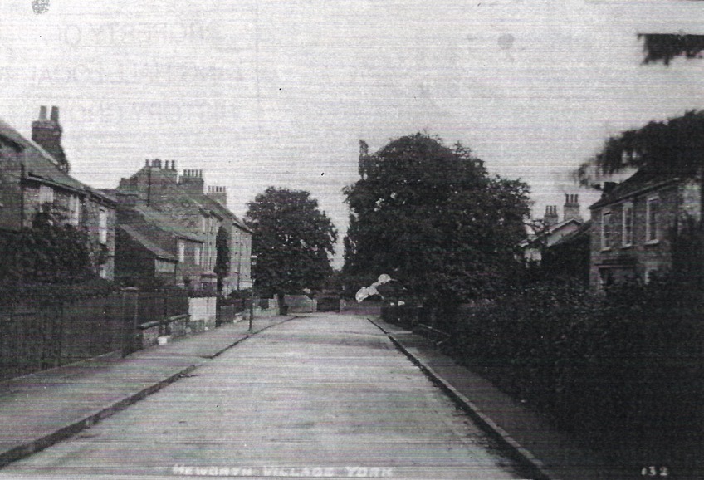
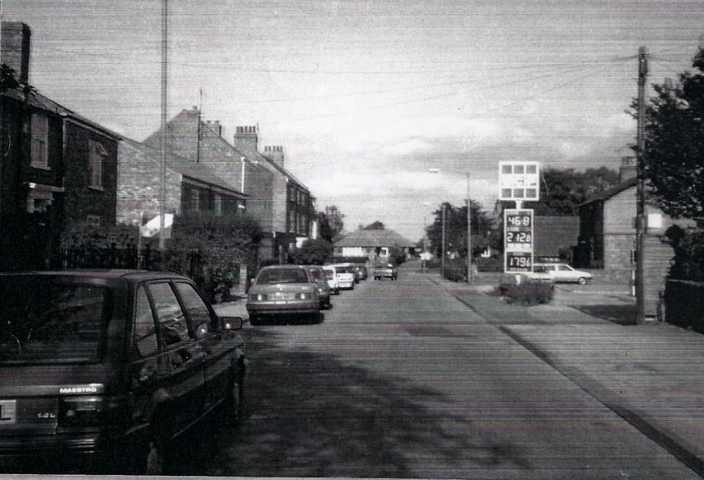
Heworth Village
Again notice the difference between the above tranquil scene in the village and the more commercial view to the right looking towards Chapmans Garage and the many parked cars

Slide 19
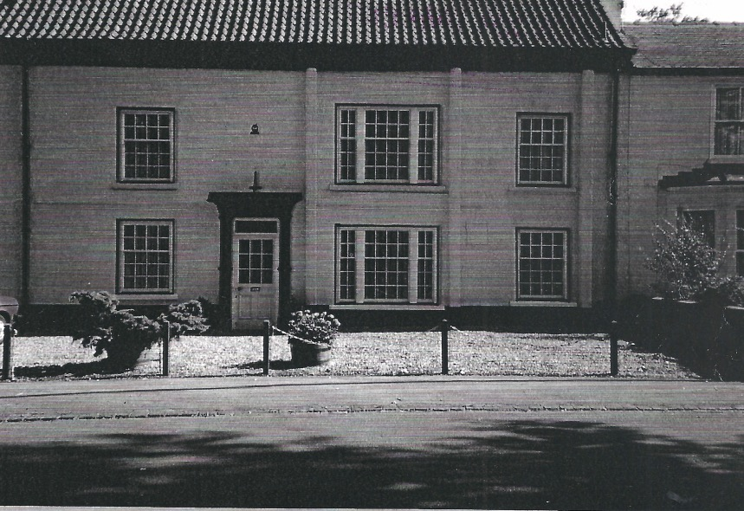
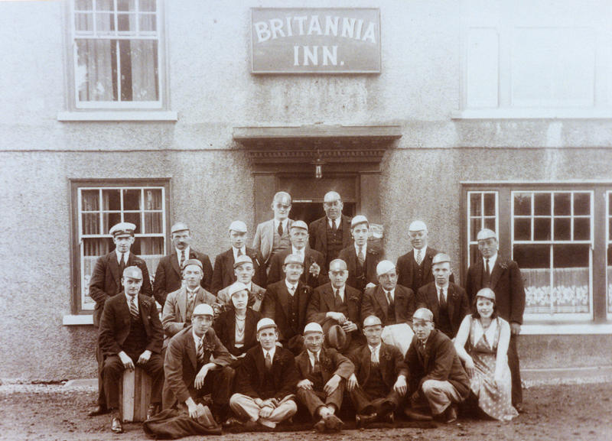
Britannia Inn
A view of the house which used to be the Britannia Inn up to about 1968
The house is opposite the Walnut Tree which took over being the village pub when the licence was transferred
The house is still owned by Mrs. Evans who with her late husband ran many of the Launderette shops in the area

Slide 20
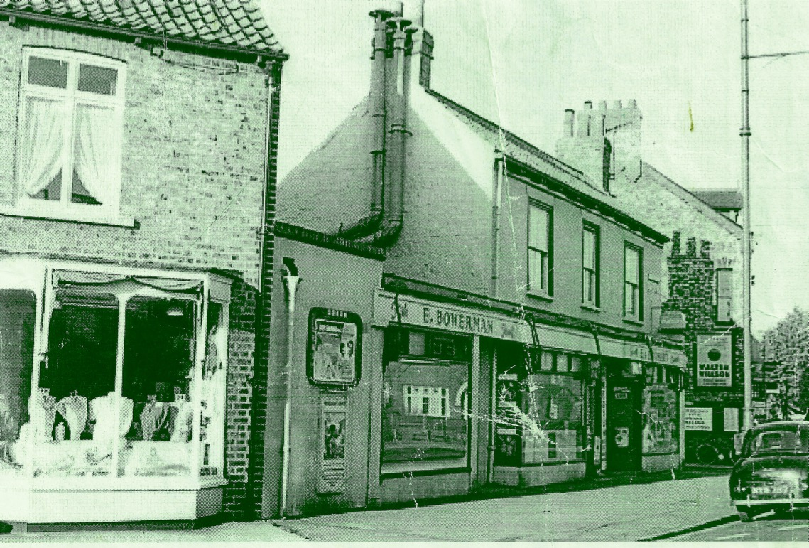
Bowerman's
A view of Bowerman's shop on the corner of Dales Lane
The left hand side of the shop sold Fish and the right hand side was a local grocers
To the left is Les Lees Drapers shop which later became Quartz Travel

Slide 21
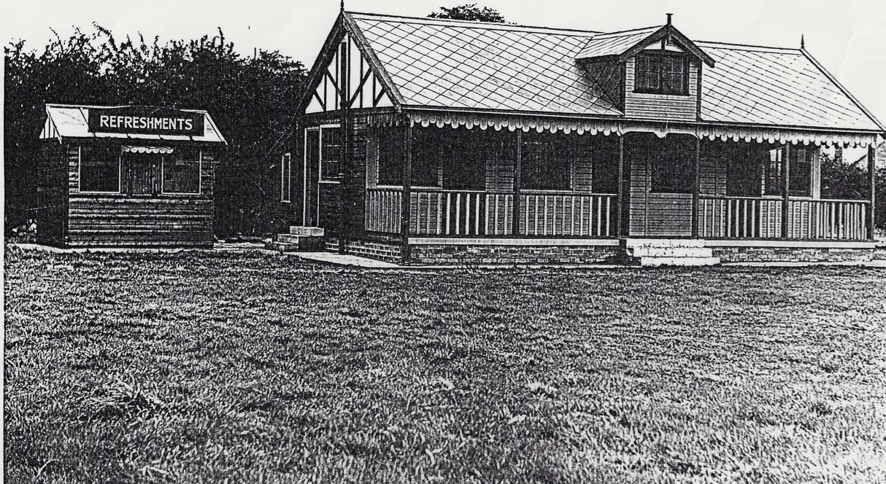
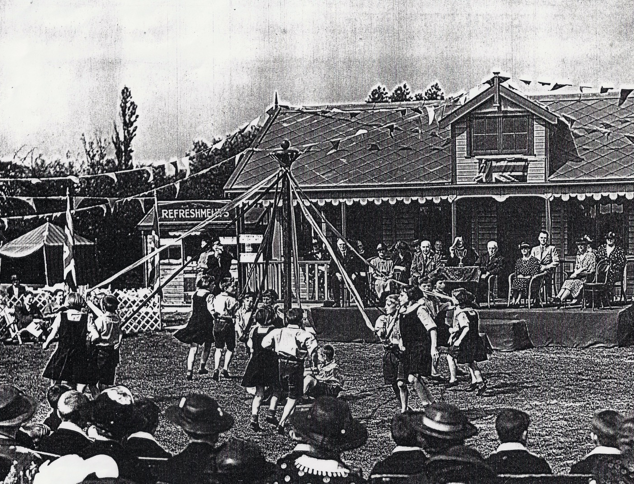
Meadow Way
Hidden away on land between Westland's Grove and Monk Stray was a delightful Cricket Club, the pictures show the Pavilion
It was originally opened by the Princess Royal for pupils of Bluecoats and Greycoats schools. It was later rented by Heworth Cricket Club before they moved to Elm Park Way

Slide 22
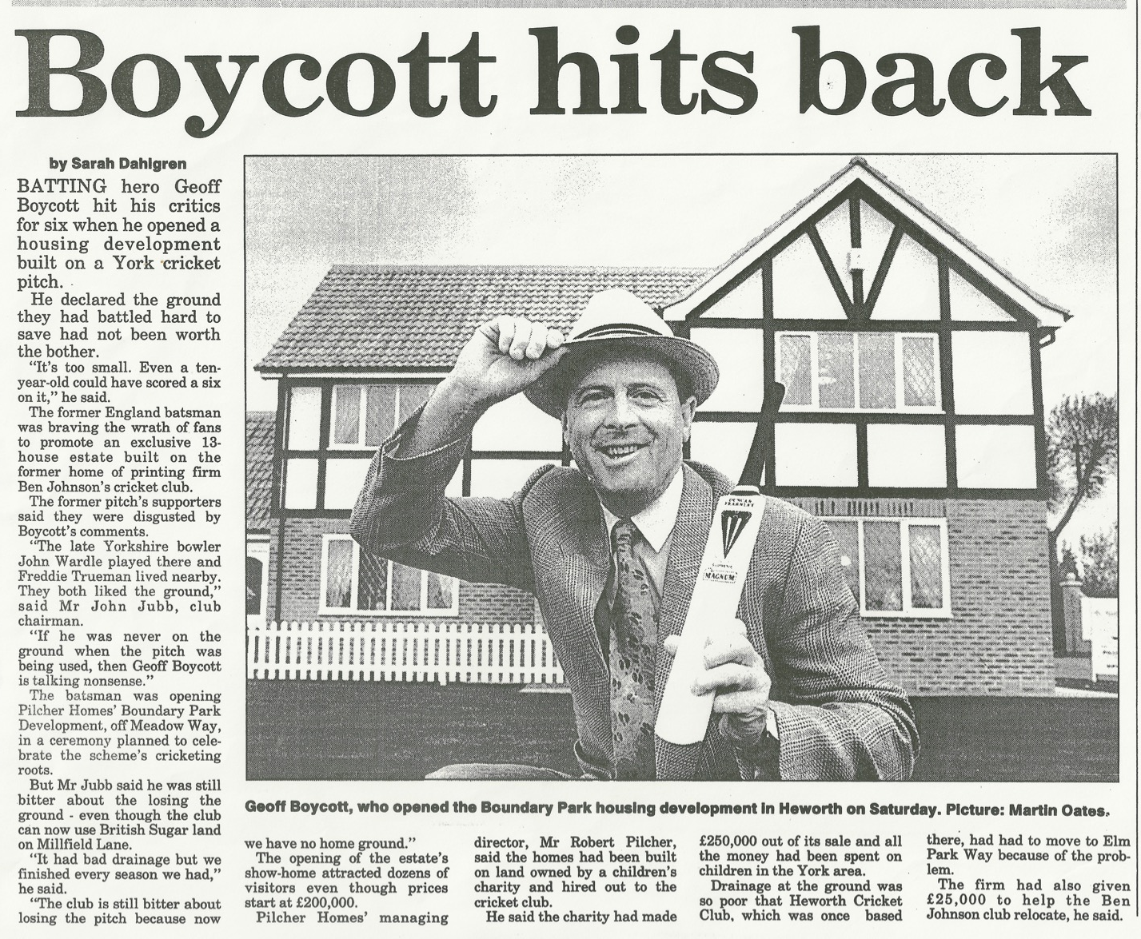
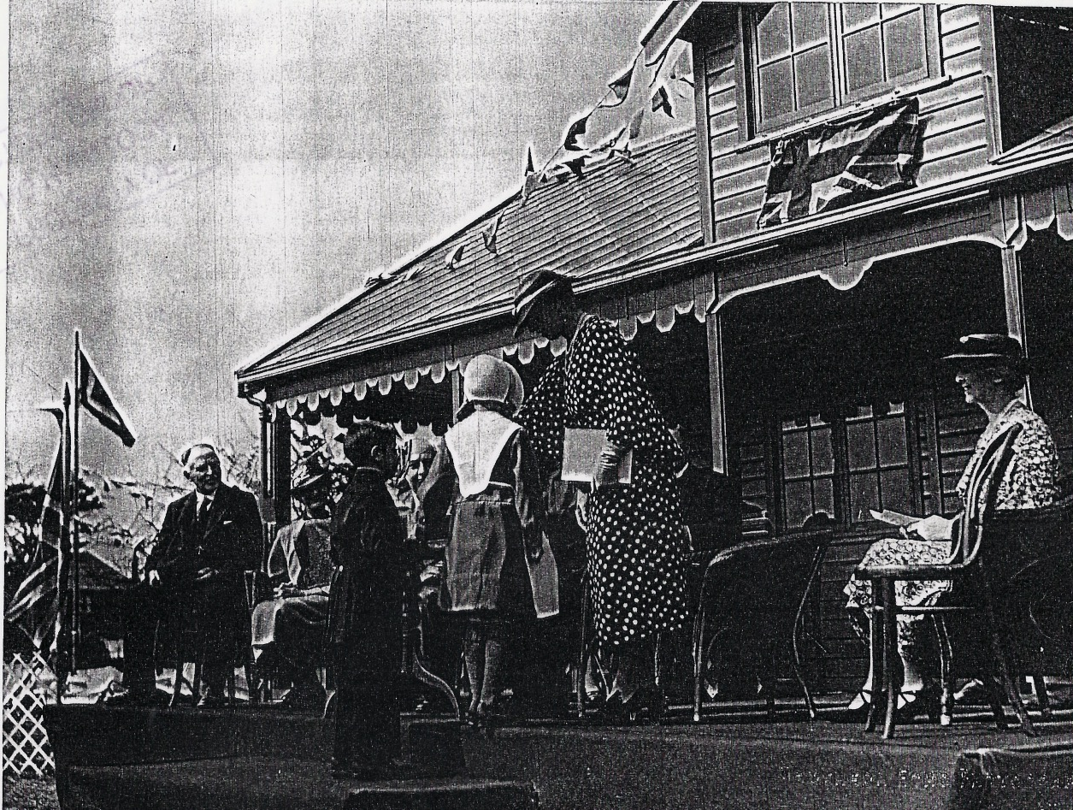
Meadow Way
After Heworth CC left the site it was taken over by Ben Johnsons on a rental basis but as with many sites eventually succumbed to being sold for Building
The article on the left shows Geoff Boycott opening the new housing estate and comments about the objections to the development

Slide 23
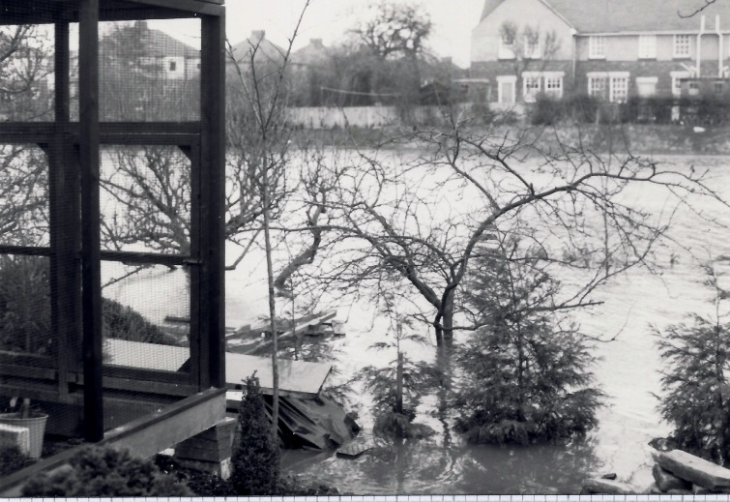
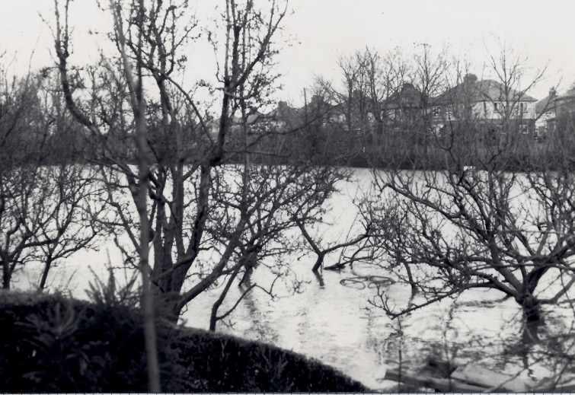
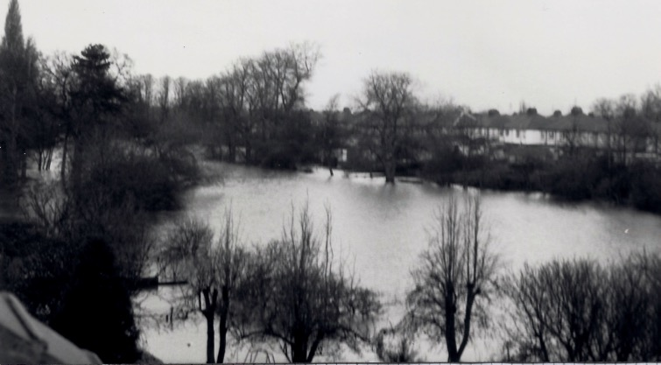
Tang Hall Floods
Tang Hall was subject to many floods over the years, before the Foss Barrier was built the River Foss would back up and much of the excess water would flood the Tang Hall & Osbaldwick becks which flow through the area

Slide 24
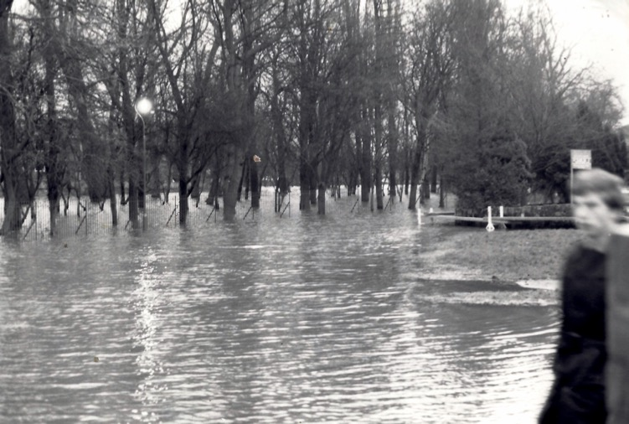
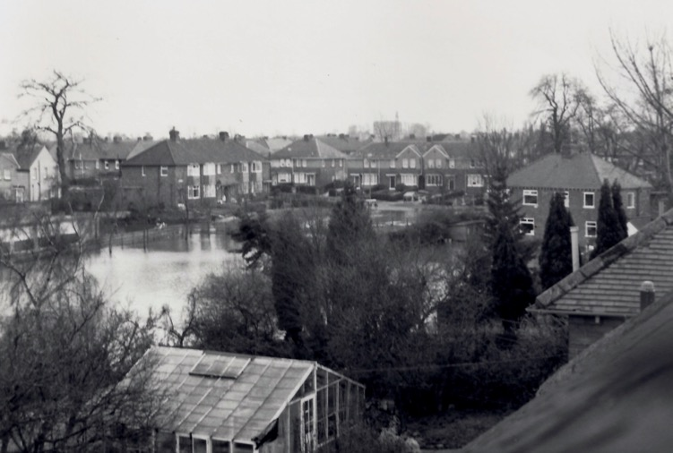
Tang Hall Floods

Slide 25
Tang Hall Floods
Regular flooding occurred in the area of the Derwent Valley Railway, Melrosegate, Tang Hall Bridge and Heworth Holme between Tang Hall Lane & Burnholme Drive. Even after the Foss Barrier was completed flooding has still occurred in the area

Slide 26
Building Tang Hall Estate
One of the largest construction sites of its time, a huge investment in Council Housing stock and built over many years starting in 1920

Slide 27
Tang Hall Park – Flaxman Avenue
The picture above shows Tang Hall Park (some people call it Hull Road Park) which was developed and opened in the late 1920’s
The pictures on the right are of the Pavilion in Flaxman Avenue (known as the Pav) which over looks the park, this used be used for weddings and parties and also used as a gardening club where residents could buy garden products at reduced prices
The pavilion was eventually demolished and replaced by a respite care home

Slide 28
Tang Hall Library
Tang Hall Library in Fifth Avenue which opened in 1962, The opening ceremony is shown on the right
Left is the renovation of Burnholme School into the new Explore Library

Slide 29
Tang Hall Bridge

Slide 30
Millfield Lane
This is the grocers shop run by Mrs. Elliot though it was thought to be owned by her brother
The shop was later sold to the Grocers Gallons Ltd

Slide 31
Tang Hall Working Men's Club

